Slide 1
Causality for Social Science
Causal inference, DAGs, and Machine Learning
Matthew Vowels
PhD, MS, MSc, BMus (Hons)
Email
Twitter
matthew.vowels@unil.ch
@matt_vowels

Slide 2
00 Course Overview

Slide 3
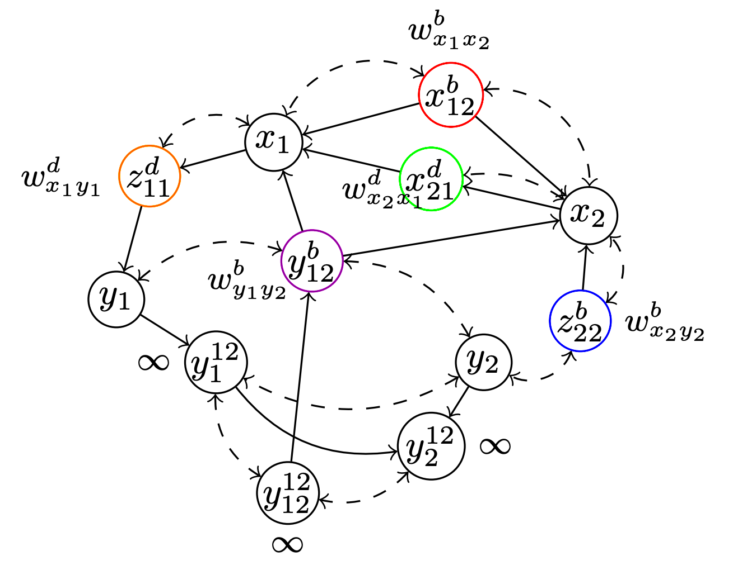
Course Schedule (approximate)
Course Page (link)
14h00-18h00 Thursdays
6th October - Theory, Causality, and Overview
Course overview
Theory vs causality
Current limitations in psychology
Overview of required tools
13th October - DAGs and Theory Specification
DAGs and graphical models
Specifying theories as DAGs
Example structures and exercises
Conditional independencies
Causal discovery
20th October - Causal Identification
Conditional independencies
Identifying the target effect
Backdoor criterion
Expressing our target effect as a function of the theory/graph
27th October - Estimation and Machine Learning
What is estimation?
Basics of machine learning and estimation
Ensembles
Example causal effect estimation
Interpreting results… semi-parametrics if we have time

Slide 4
Course Schedule
Lecture Format
…10-15 min breaks once per hour!
…Regular exercises - work together or alone (as you like)
…Coding in R (or Python if you prefer…) I’d like to do some ‘code-alongs’ if we have time!
…Regular discussion and questions welcome
…Let me know if you’re getting lost!

Slide 5

Example Code-Alongs
Doing train/validation/test splitting in code…
rf_preds_train <- predict(rf, newdata = all_train_split)
lr_preds_train <- predict(lr, newdata = all_train_split)
dt_preds_train <- predict(dt, newdata = all_train_split)
rf_preds_val <- predict(rf, newdata = all_val_split)
lr_preds_val <- predict(lr, newdata = all_val_split)
dt_preds_val <- predict(dt, newdata = all_val_split)
Generate train and validation predictions
rf_mse_train <- mean((all_train_split$outcome - rf_preds_train)^2)
rf_mse_val <- mean((all_val_split$outcome - rf_preds_val)^2)
lr_mse_train <- mean((all_train_split$outcome - lr_preds_train)^2)
lr_mse_val <- mean((all_val_split$outcome - lr_preds_val)^2)
dt_mse_train <- mean((all_train_split$outcome - dt_preds_train)^2)
dt_mse_val <- mean((all_val_split$outcome - dt_preds_val)^2)
Evaluate RF, LR and DT
Algo. | Train MSE | Validation MSE
LR | 1.026 | 0.934
RF | 0.766 | 1.076
DT | 1.009 | 1.043
Test MSE
lr_preds_test <- predict(lr, newdata = all_test_split)
lr_mse_test <- mean((all_test_split$outcome - lr_preds_test)^2)
1.17

Slide 6

Machine Learning Basics
Doing train/test splitting in code…
Split into train + val combined and test separately:
X_train_val, X_test, y_train_val, y_test = train_test_split(X, y, test_size=0.2, random_state=42)
X_train, X_val, y_train, y_val = train_test_split(X_train_val, y_train_val, test_size=0.25, random_state=42)
rf = RandomForestRegressor()
dt = DecisionTreeRegressor()
lr = LinearRegression()
rf.fit(X_train, y_train)
dt.fit(X_train, y_train)
lr.fit(X_train, y_train)
rf_preds_train = rf.predict(X_train)
dt_preds_train = dt.predict(X_train)
lr_preds_train = lr.predict(X_train)
rf_preds_val = rf.predict(X_val)
dt_preds_val = dt.predict(X_val)
lr_preds_val = lr.predict(X_val)
Repeat to split combined train+val into separate splits
Define and fit algorithms
Generate train and validation predictions

Slide 7
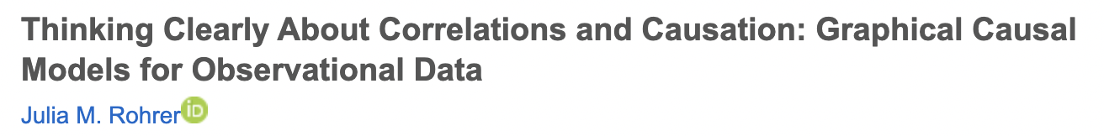
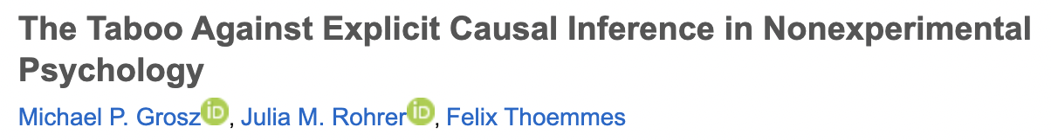
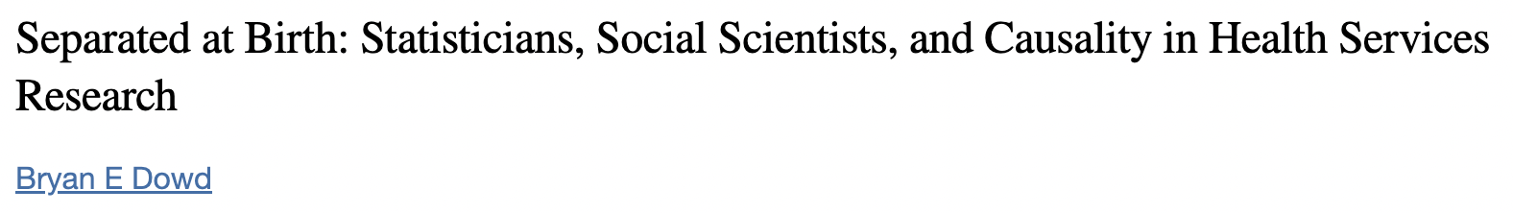
Resources
DAGitty
http://dagitty.net/
https://journals.sagepub.com/doi/10.1177/2515245917745629
https://journals.sagepub.com/doi/10.1177/1745691620921521
https://www.ncbi.nlm.nih.gov/pmc/articles/PMC3064910/

Slide 8
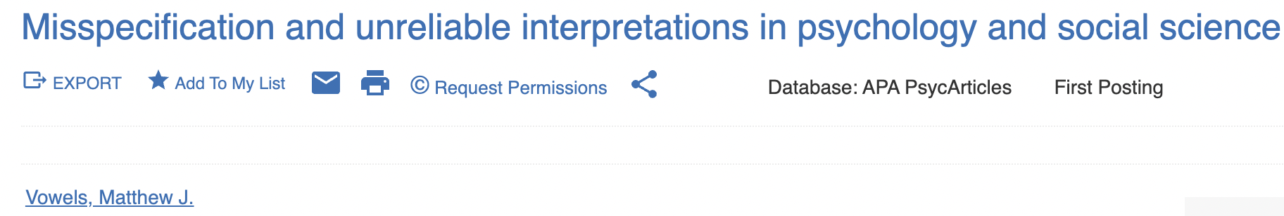
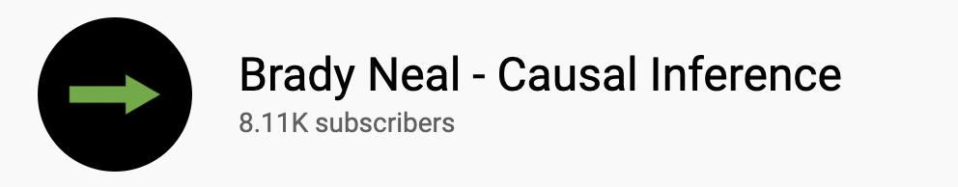
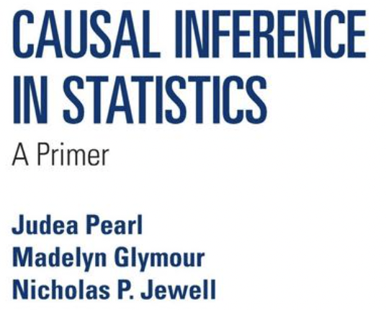
Resources
https://psycnet.apa.org/doiLanding?doi=10.1037%2Fmet0000429
https://arxiv.org/abs/2206.05175
https://www.youtube.com/c/BradyNealCausalInference
http://bayes.cs.ucla.edu/PRIMER/

Slide 9
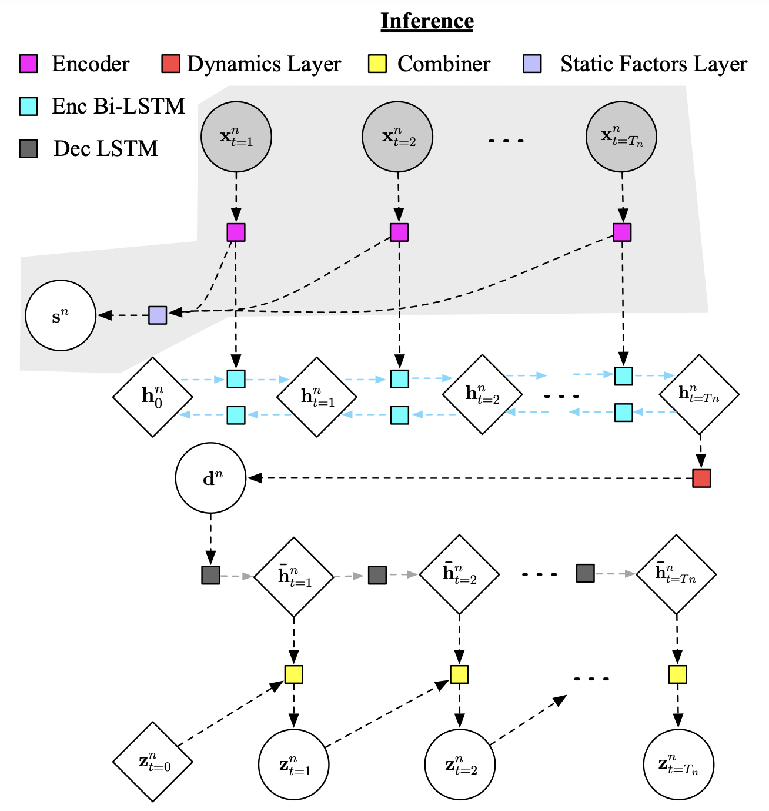
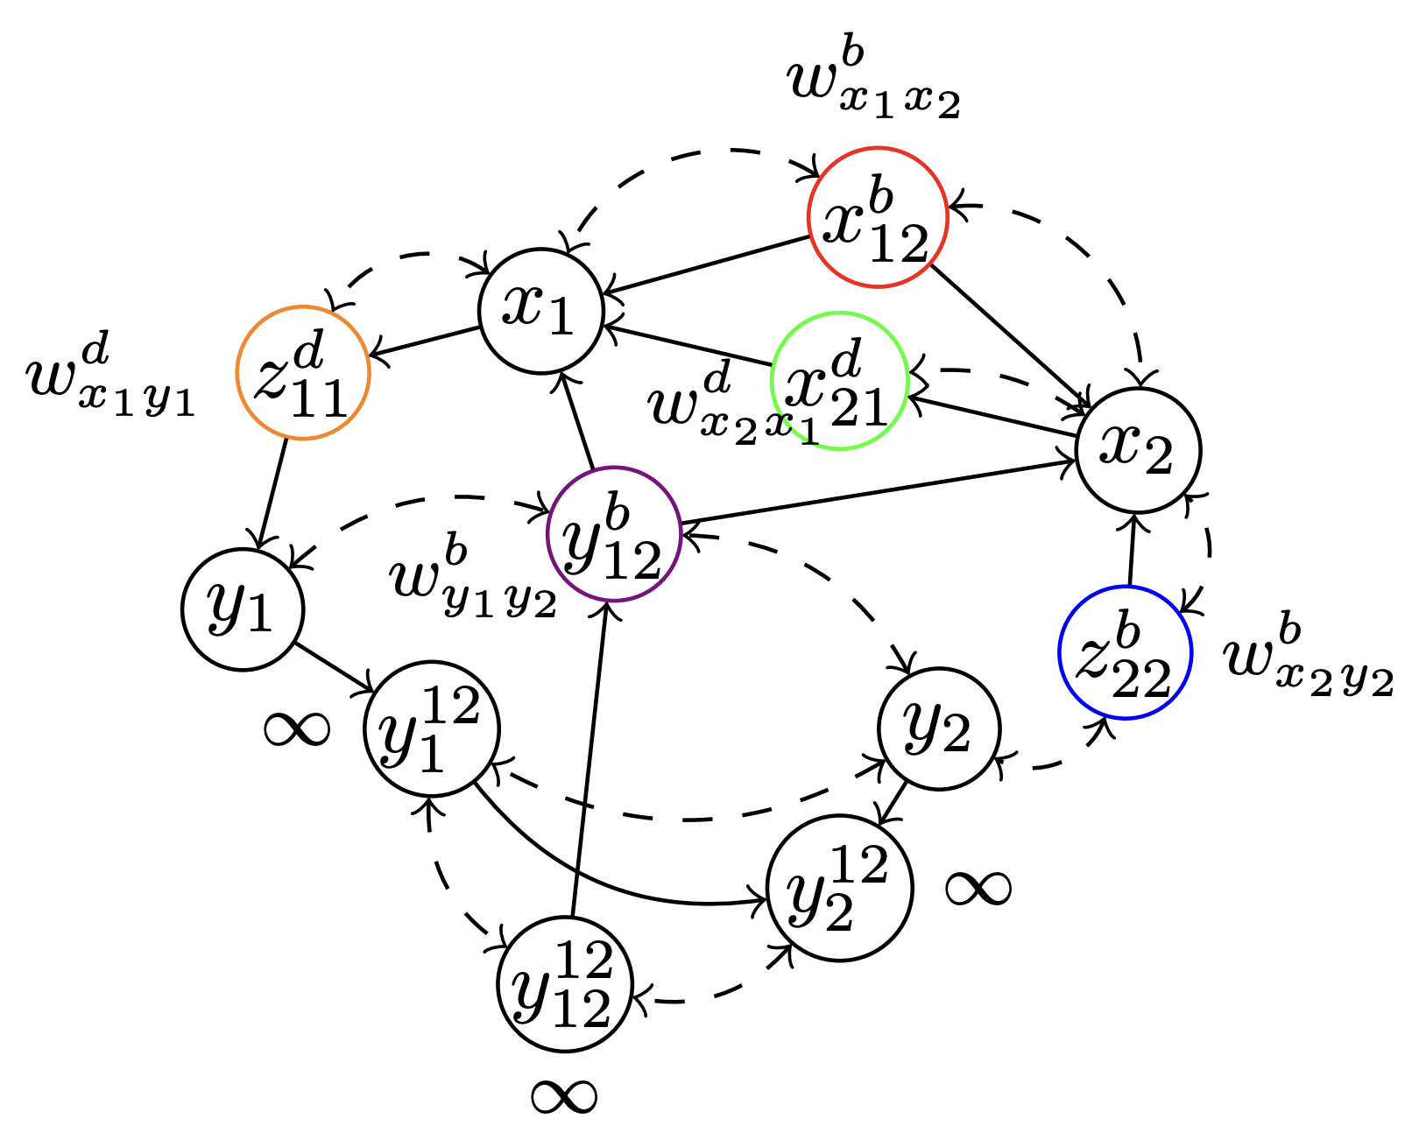
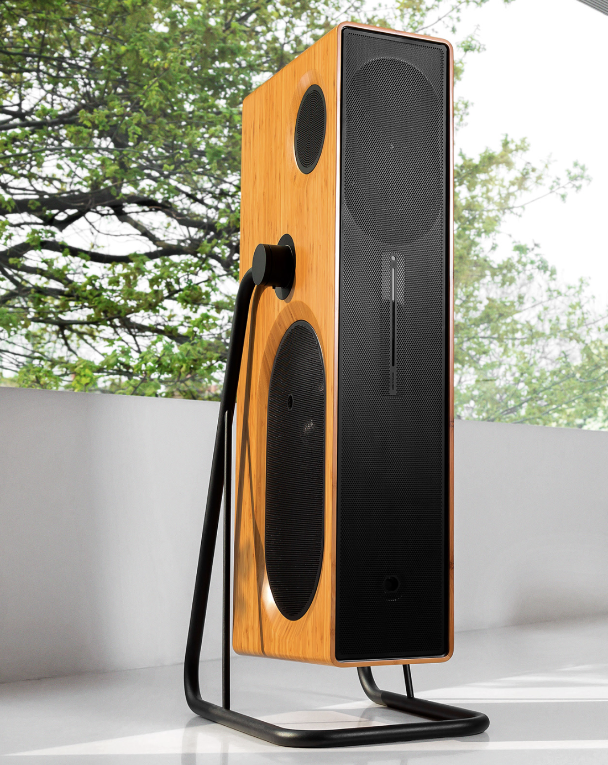
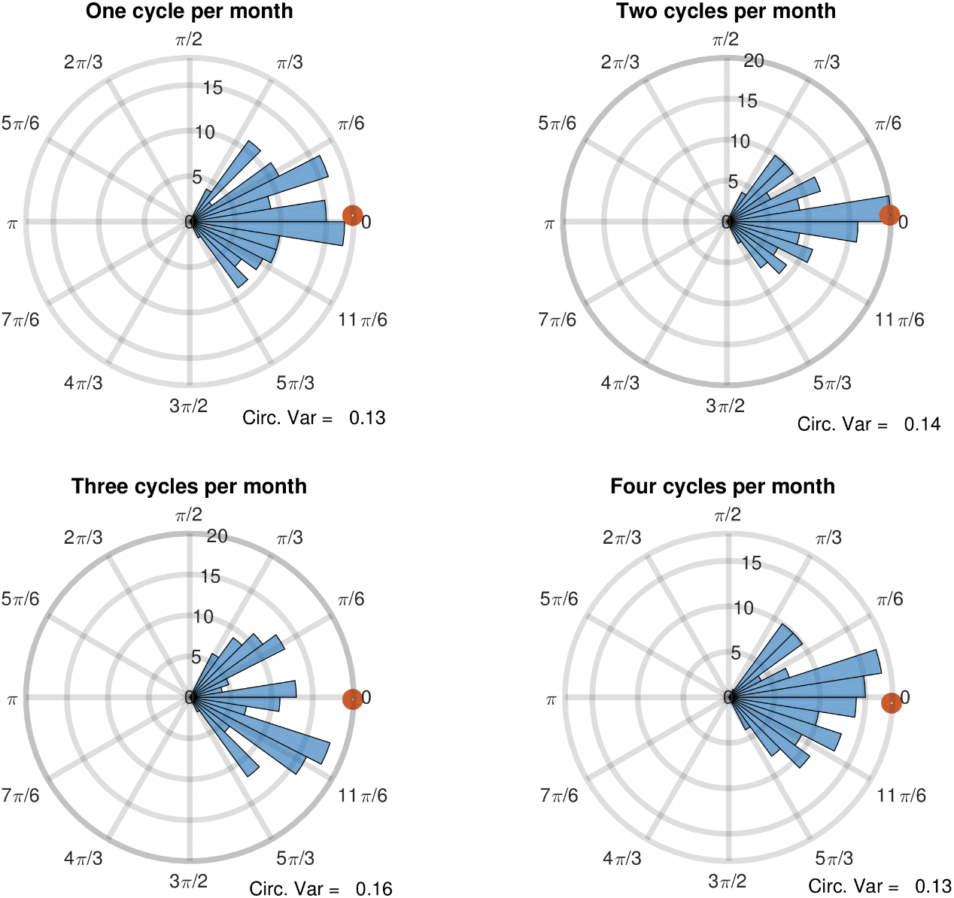
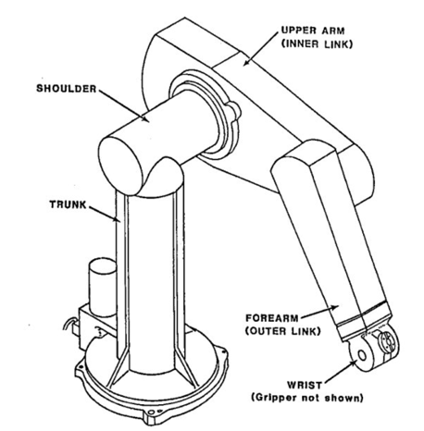


Who am I?
Started as electroacoustic design engineer
Subjective evaluation / psychoacoustics
Musician / mix engineer
MS Family Science - applying engineering techniques to time series data
MSc ML, CV and Space Robotics
PhD Machine learning, computer vision, causality
Currently 2nd PhD integrating ML and causality into social science

Slide 10
This Course
Theory
Specifying a world model/process which helps us to understand natural phenomena.
Causality
Machine Learning
Tools for deriving causation from correlation/association.
Tools for estimating quantities with minimal assumptions about the functional or parametric form.

Slide 11
Questions?

Slide 12
01 Motivation
“To question the foundations of a discipline or a practice is not necessarily to deny its value, but rather to stimulate a judicious and balanced appraisal of its merits.”
ter Meulen & Ashcroft, 2004

Slide 13

Causality and Theory
“Well-developed scientific theories facilitate the classic scientific goals of understanding, prediction, and control.”
Van Dongen et al., 2022, p. 6
“There is nothing in the joint distribution of symptoms and diseases to tell us that curing the former would or would not cure the latter.’’
Pearl, 2009

Slide 14
Causality and Theory
Going to hospital is correlated with being sick
If we stop people from going to the hospital will it reduce the number of sick people?
Going to bed with shoes on is correlated with waking up with a headache
If we prevent people from wearing shoes to bed, will it reduce headaches in the morning?
Causality is essential when understanding the world, so that we may manipulate/improve/modify/intervene
We need causal knowledge to reason about ‘what if?’ type questions
Non-causal methods do not respect these distinctions
Theories in psychology are already causal
When?
Which?
How much?
Vs
How?
Why?
What if?

Slide 15
Causality and Theory
‘We think of a cause as something that makes a difference, and the difference it makes must be a difference from what would have happened without it. Had it been absent, its effects – some of them, at least, and usually all – would have been absent as well.’
Lewis 1973

Slide 16
Where Are We Today?
“Correlation is not causation!!!”
E. Veryone (forever)
(necessarily)

Slide 17
Where Are We Today?
‘…the literature on causal inference must be one of the oddest literatures in all of academia. Where else in the modern sciences can one find literature reviews that routinely begin in the 1700s (e.g., Holland 1986); where the past 100 years of research is labeled “a century of denial” (Pearl 1997); where Bertrand Russell is called stupid (Kempthorne 1978); and where pillars of the field seem oblivious to decades-old developments in their own area of expertise? How is it that the most important question in all of empirical analysis could remain so controversial after being considered for so long a time by so many brilliant minds?’
Dowd, 2011

Slide 18
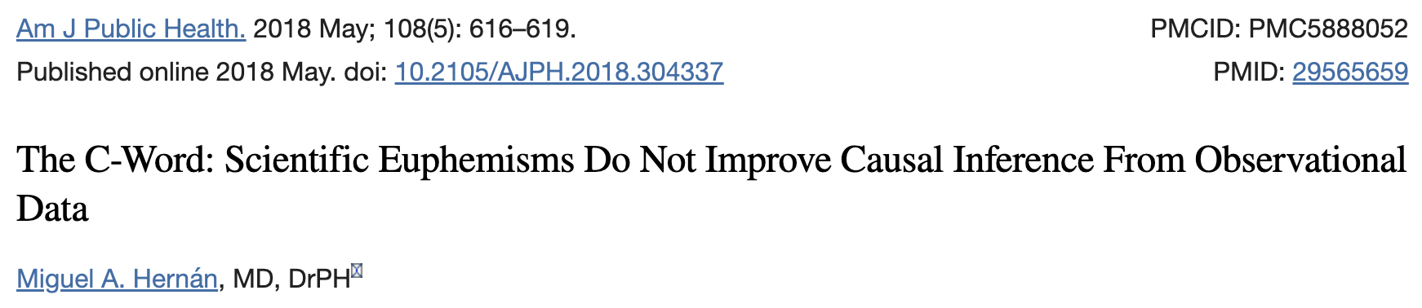
Where Are We Today?

Slide 19
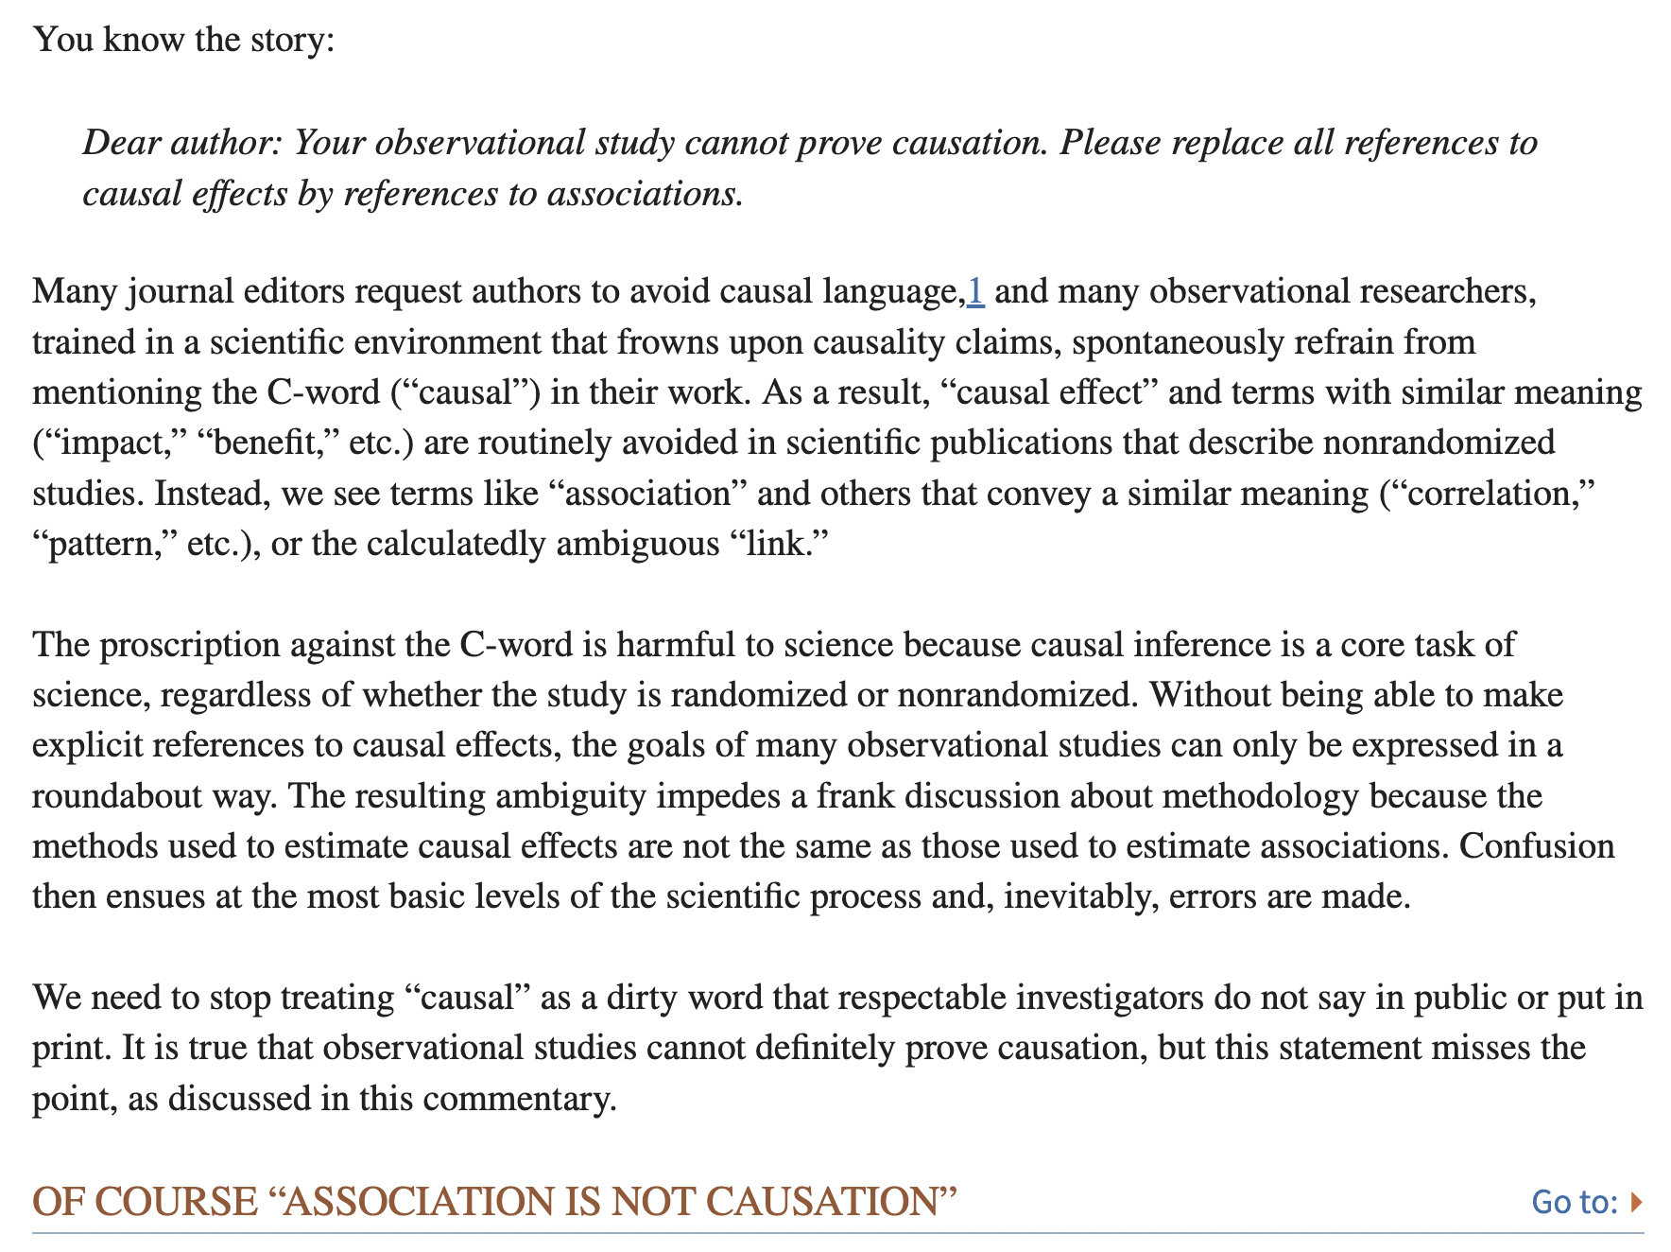
Where Are We Today?

Slide 20
Where Are We Today?

Slide 21
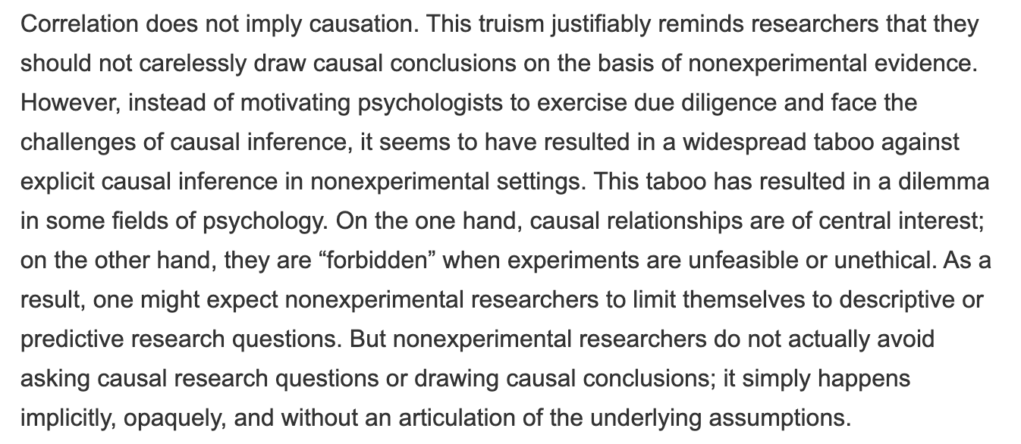
Where Are We Today?
We should be getting bored of hearing this by now…

Slide 22
Where Are We Today?
Ok… so
Causality has been neglected - the tools are there but we don’t use them
It is central to science
We kinda do it anyway, because we want to do science, but we do it badly
This leads to meaningless inference (as we’ll come to see)

Slide 23
And what about our theories?
“…most claims in the literature are so critically underspecified that attempts to empirically evaluate them are doomed to failure—they are not even wrong. Meta-scientists should beware of the flawed assumption that the psychological literature is a collection of well-defined claims. To move beyond the crisis, psychologists must reconsider and rebuild the conceptual basis of their hypotheses before trying to test them.”
Scheel, 2022
We have no formal framework for the specification of our theories…
As a consequence they are untestable.

Slide 24
And what about our theories?
“For me, a problem with much of psychology is that we have had to pretend to have theories even when we were actually just describing phenomena or “proto-theorising.” That’s why our discipline is full of silly-sounding theories like five-factor theory, which is the theory that there are often five factors, or social identity theory, which is the theory that people have social identities that are important to them; or statements like ‘life history theory predicts…’ where the actual empirical regularity seems to bear no relation to the cited body of formal theory [...]
But, another reform I would like to see is people not feeling the need to claim that they have a ‘theory’ when they’re really just doing natural history or proto-theorizing. At present, people are as guilty of CITEing (Calling It ‘Theory’ for Effect) as they are of HARKing (Hypothesizing After the Results are Known). It ought to be quite fine to say that we are testing some intuitions about what kind of factors affect this process, or investigating different ways of measuring something, with the cheerful admission that there’s no real theory yet.”
Nettle, 2021, on Medium

Slide 25
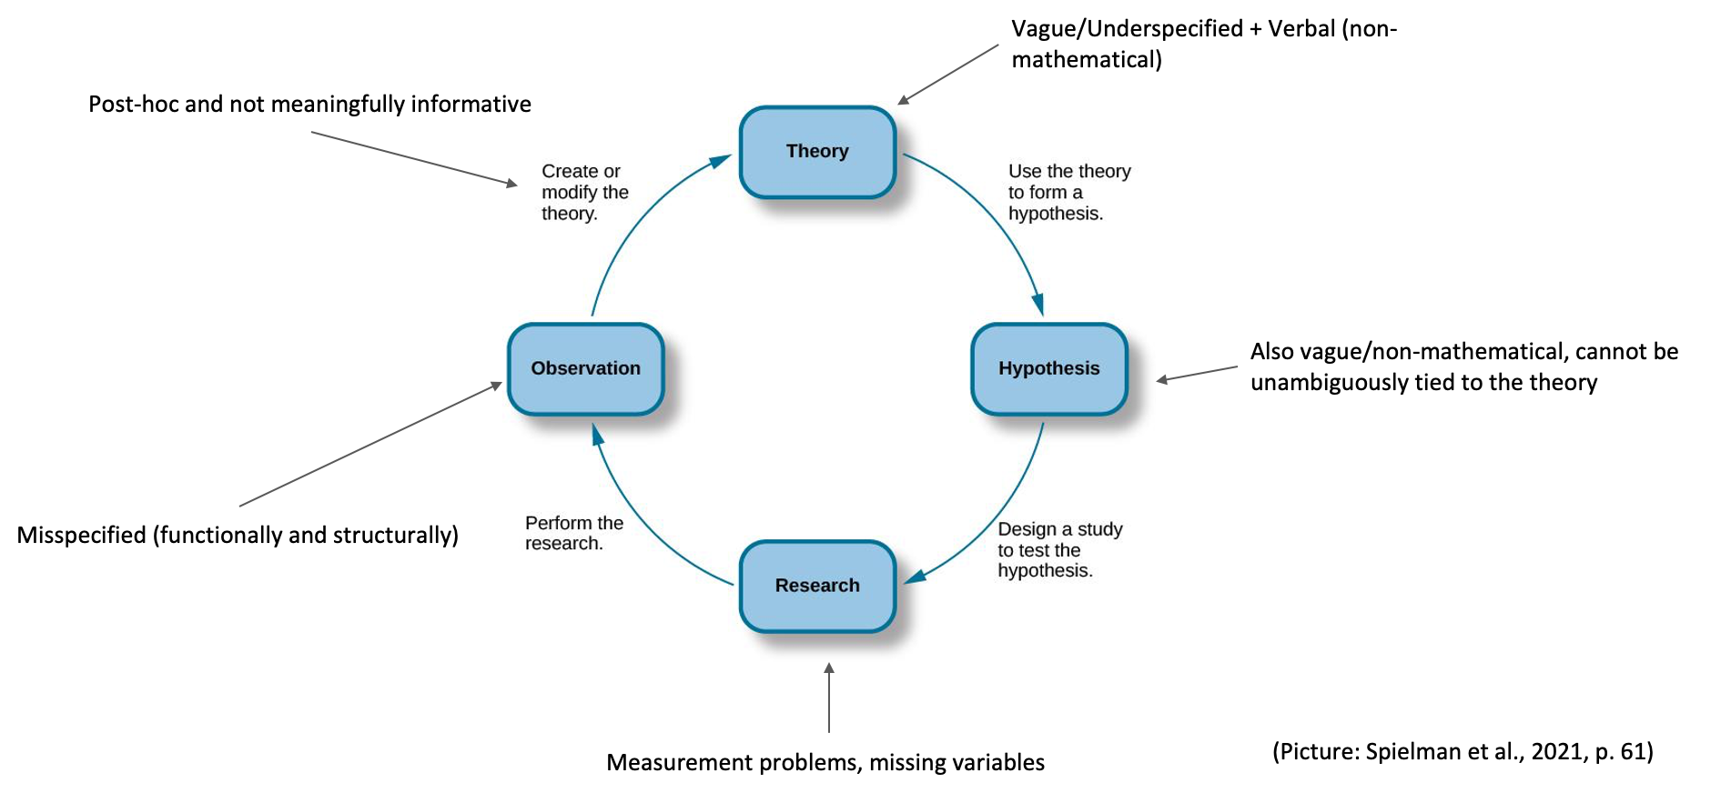
And what about our theories?

Slide 26
And what about our theories?
“Explain the phenomena by representing the particular parts of the real world and the relationships among them that give rise to the phenomena of interest” (Haslbeck et al., 2021, p. 2; see also Van Rooij & Baggio, 2020)
Theories should be relevant, precise, unambiguous (i.e., independent of creator), falsifiable, generalisable, predictive, parsimonious (Note that there are many lists of criteria: Quistberg & Sakaluk, 2021)
Need to define (Scheel et al., 2021)
Concepts
Measurement function
Causal structure
Conditions
Assumptions

Slide 27
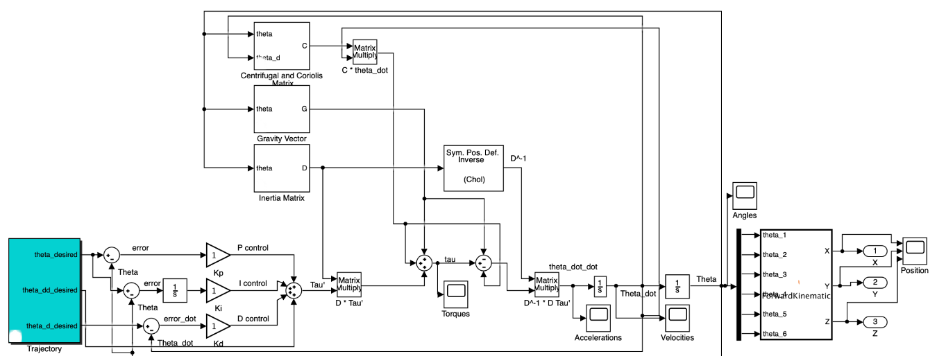
And what about our theories?
Assumptions/abstractions/parsimony should not be so strong as to render the model meaningless!

Slide 28
And our general assumptions?
Everything is correlation (even when it isn’t)
(Causal) theories are assumed true a priori and not properly validated or tested
Theories are untestable
Everything is linear

Slide 29
And our general assumptions?
Due to [these assumptions], models that are so unrealistic that they are indexed by a finite dimensional parameter are still the status quo, even though everybody agrees they are known to be false.
van der Laan, M.J. (2015)
Statistics as a Science, Not an Art: The Way to Survive in Data Science

Slide 30
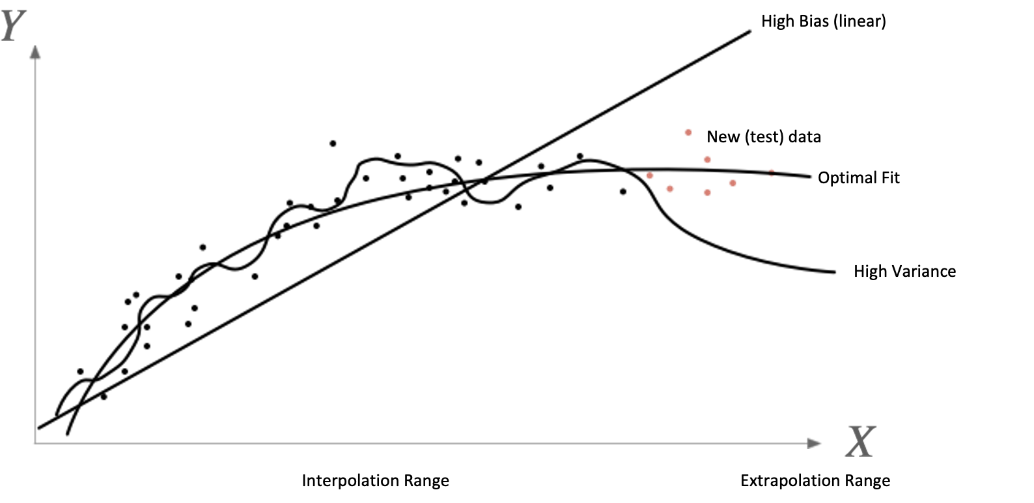
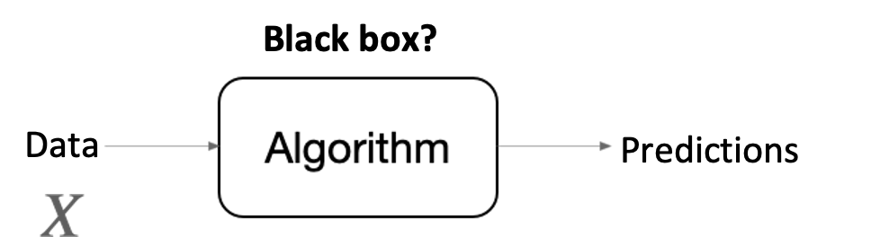
ML
Machine Learning:

Slide 31
ML
Family of linear models
Family of ‘all’ models
$$y=0.2+0.5X_{1}+0.2X_{2}+ϵ$$
$$y=f_{1}(X,U_{X})$$
$$y=0.24+0.21X_{1}+0.78X_{2}+ϵ$$
$$y=f_{2}(X,U_{X})$$
…
…

Slide 32
ML
With machine learning come new concerns…
- Explainability
- Fairness
- Data leaks
- Statistical inference

Slide 33
Summary
•What is theory and how do we typically represent it?
•Verbal
•Causal
•Generic / informal
•What are the current problems with theory specification in psychology?
•Untestable/vague - Scheel (2021); Navarro (2021).
•No formal process for theory development
•Theory ‘crisis’ - Oberauer & Lewandowsky (2019)
•Not enough triangulation
•This also leads to:
•Replication issues
•Estimation problems
•What are solutions to these problems?
•Non-parametric models – Yarkoni & Westfall (2017); Vowels (2021, 2022b)
•Causality / formal theory specification
•Explicit causality – Hernan (2018); Grosz et al. (2020); Rohrer (2018)
•Graphical causal models for observational data – Vowels (2021)
•Mathematical formalism – Navarro (2021)
•Computational models – Oberauer & Lewandowsky (2019)
And this is ignoring difficulties associated with measurement…

Slide 34
Kinda worrying, but…
We are doing research at a time where we have access to
Open source code
YouTube videos
Online courses
Open science movement
Lots of articles
This is a great opportunity to start changing the way we approach research

Slide 35
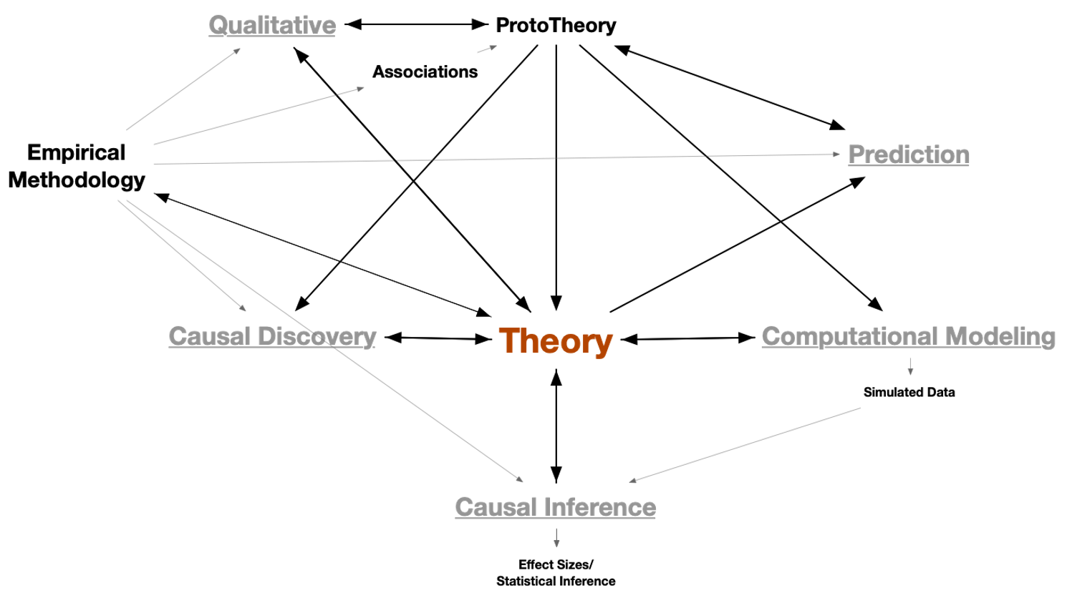
Qualitative and associations/correlations can help us identify a phenomenon to begin forming a prototheory
Qualitative studies can be used throughout for validation
Theory can inform useful predictive variables for utility tasks (e.g. automation)
Theory informs data collection methodology
Causal discovery
helps us uncover unknown substructures
Simulated data can be used to check validity of computational model
Iterative triangulation with
formal specification!
Integrate Machine Learning Tools

Slide 36
In this course
Reframe well-known statistical concepts in the context of what we actually care about (causality), and in a way which is theoretically consistent
Deal with the causal inference part of the big theory/analysis ‘web’
Part of this will force us to formalise our theory (even if technically it is not quite ready for this…)
With this formal theory we will be able to specify our hypotheses as functions of components of the theory
We can then estimate the things we really care about unambiguously
We can use ML estimators to help us do this without unreasonable assumptions

Slide 37
In this course
DAGs and SCMs - Directed Acyclic Graphs and Structural Causal Models
These provide us with a framework for formalising our theories and helping us with our hypotheses and analyses
Causal Inference and Control Variables
Estimation and Machine Learning
After this course
You will be able to start formalising your theories
Be able to specify research questions as unambiguous functions of your theory
Be able to estimate causal effects which can be tied directly to your theoretical assumptions
Be able to use data-adaptive techniques for estimation (and thereby avoid unnecessary assumptions)
We will go at your pace!

Slide 38
Questions?

Slide 39
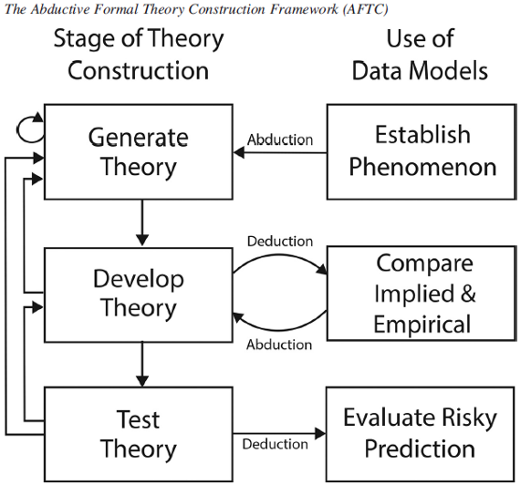
Exercises
(Picture: Haslbeck et al., 2021, p. 15)
Phenomena: What is/are the phenomenon/phenomena you are interested in? How would you define it/them? What are the relevant constructs? Let’s use and develop this as we progress through the course.
Research Questions: Are you interested in causal or correlational analyses - what language do you use when reporting/interpreting results?
Interpretations: For your own research, can you articulate the difference between causal approaches (aiming to answer ‘how?’, ‘why?’, and ‘what if?’ questions, from ‘When?’, ‘How much?’, or ‘What?’ type questions?

Slide 40
02 DAGs and Theory Specification

Slide 41
Plan
Re-motivate
Introduce DAGs
Some examples of DAGs in psychology
Challenges
Rules of DAGs and conditional independencies
We will assume linearity for most of this, to keep things simple.

Slide 42
Re-motivation - an alternative angle
Recall that theories are (almost all) underspecified and untestable in psychology (prototheories)
We need something formal and unambiguous
This will help us
Think more carefully about the specifics of our theory
Understand if what we care about is testable in practice
Design the data collection methodology

Slide 43
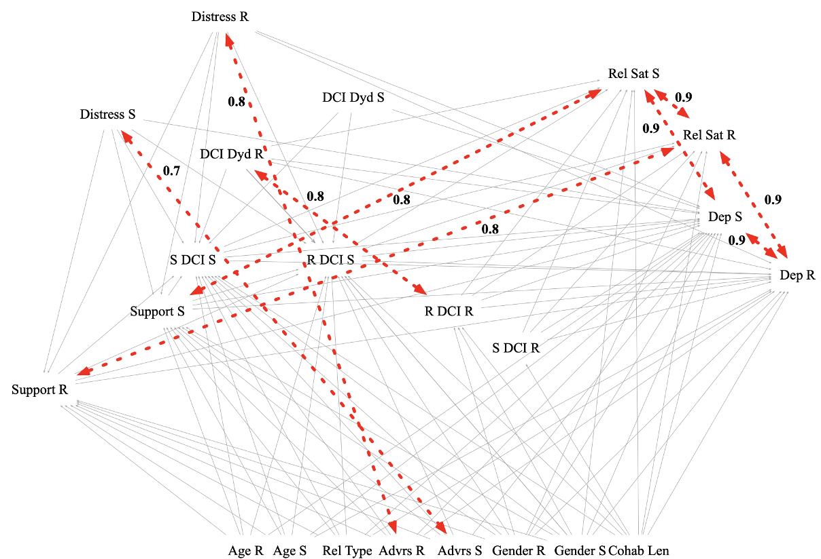

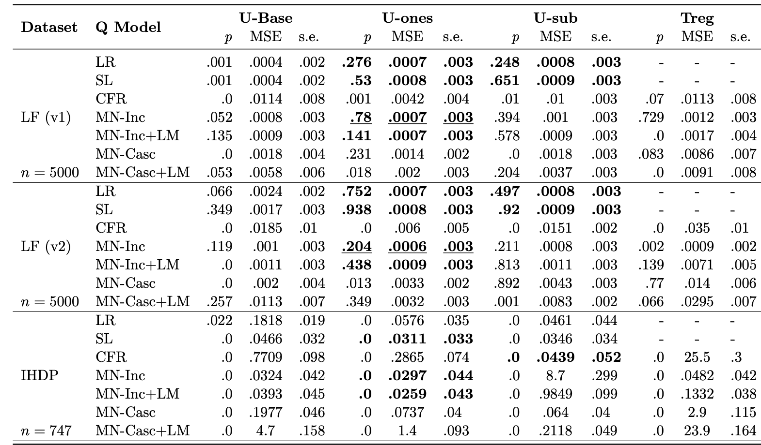
Re-motivation
We want all these components to be consistent with each other!
There exists a (complicated!) real-world causal process
+ research question/estimand
Our Model/Theory
Our analysis
…that gives rise to a set of states.
We can (partially) observe these states.

Slide 44
Re-motivation
 | Drug | No Drug
Men | 81/87 recovered (93%) | 234/270 recovered (87%)
Women | 192/263 recovered (73%) | 55/80 recovered (69%)
Combined | 273/350 recovered (78%) | 289/350 recovered (83%)
Good for men! 93% vs 87%
Good for women! 73% vs 69%
Bad for… people? 78% vs 83%
So… Should we prescribe the drug or not?!
Pearl, Glymour, Jewell, 2016

Slide 45
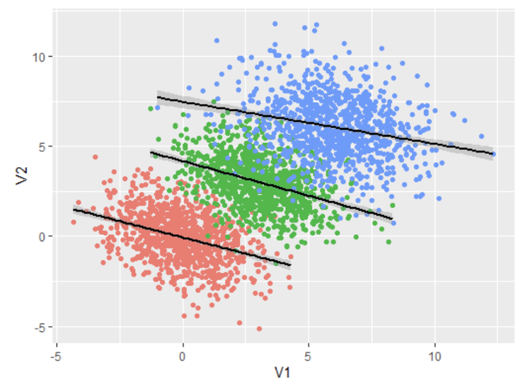
Re-motivation
Simpson’s “paradox”…
Described by Pearl as ‘a tale of statistical agony’

Slide 46
Re-motivation
We need causality for this… Adding this knowledge, for example:
Estrogen has a negative effect on recovery
Women take the drug more than men
Thus selecting drug users at random, they are more likely to be women
They are thus less likely to recover
We thus need to compare subjects of the same gender, ensuring that differences in recovery rates are not ascribable to estrogen (thus, we need to <condition> on the gender)
pp. 2-3 Pearl, Glymour, Jewell, 2016

Slide 47
Re-motivation
We can represent this situation graphically as follows:
As we will see… we can use the graph to understand which variables we need to “condition on”
Causal mechanism resulting in use skew (e.g. advertising)
Gender
Causal mechanism due to estrogen
Drug User
Recovery
Causal mechanism due to drug
pp. 2-3 Pearl, Glymour, Jewell, 2016

Slide 48
Re-motivation
For example… if the graph looked like this:
Causal mechanism of drug lowering blood pressure
Blood Pressure
Lower blood pressure causes recovery
Drug User
Recovery
Toxic mechanism due to drug
pp. 2-3 Pearl, Glymour, Jewell, 2016

Slide 49
Re-motivation
Exactly the same data, numerically!
 | Drug | No Drug
Low BP | 81/87 recovered (93%) | 234/270 recovered (87%)
High BP | 192/263 recovered (73%) | 55/80 recovered (69%)
Combined | 273/350 recovered (78%) | 289/350 recovered (83%)
But here, if lowering BP is a mechanism which affects recovery, it makes no sense to separate the data based on BP
In this case, BP is a mediator of the effect from drug to recovery.
pp. 2-3 Pearl, Glymour, Jewell, 2016

Slide 50
Re-motivation
So… Knowing the graph means we know when to condition on information.
And Simpson’s paradox is only a paradox to those without causal knowledge.
Gender
Blood Pressure
Drug User
Recovery
Drug User
Recovery

Slide 51
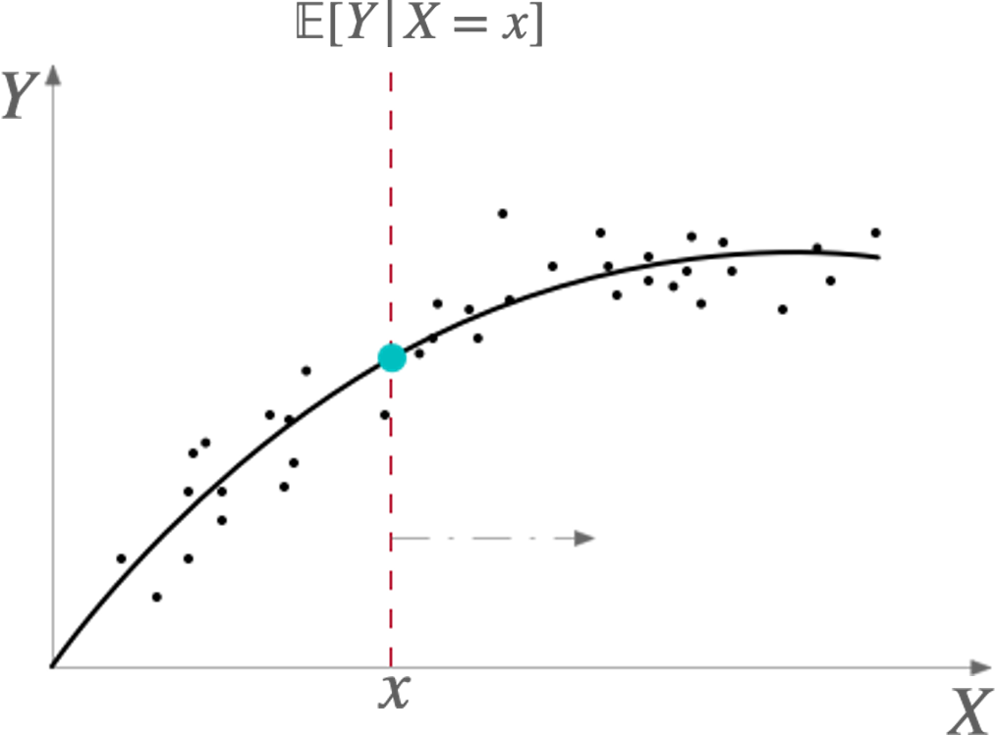
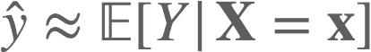
A little (imprecise) math…
Our <linear> model:
$$y=β_{0}+β_{X}X+ϵ$$
This can be used for:
$$E[Y|X=x]=∫yf(y|x)dy$$
$$E[Y|X=x]≈N^{-1}\underset{i}{∑}y_{i}|X=x$$

Slide 52
A little math…
If we ‘fit’ our model:
$$y=β_{0}+β_{X}X+ϵ$$
Using e.g. OLS…
And generate predictions for y with the following values for X:
$$X=1$$
$$X=0$$
We get a value equivalent to:
$$β_{X}$$
Which tells us ‘how much the outcome changes for a one unit change in the input’
Or equivalently:
$$E[Y|X=1]-E[Y|X=0]$$

Slide 53
A little math…
$$E[Y|X=1]-E[Y|X=0]$$
Right now, this quantity is not necessarily causal, it just tells us how the regression model behaves.
But if we use causal methods…

Slide 54
A little math…
Conditioning Statement
This can be reframed slightly:
$$E[Y|X=1]-E[Y|X=0]$$
Treatment
No Treatment
Signifies intervention
$$\text{Average Treatment Effect}=E[Y|do(T=1)]-E[Y|do(T=0)]$$
Outcome you are interested in
Expectation - kind of like a long-run average
Difference between two expectations

Slide 55
A little math…
Conditioning Statement
Treatment
No Treatment
Signifies intervention
$$\text{Average Treatment Effect}=E[Y|do(T=1)]-E[Y|do(T=0)]$$
Outcome you are interested in
Expectation - kind of like a long-run average
Difference between two expectations

Slide 56
A little math…
In Experimental Conditions -> | do(T=1) and | do(T=0) is the same as | T=1 and | T=0
Drug T=1 | No Drug T=0
1 | 0
1 | 1
0 | 0
1 | 0
1 | 1
1 | 1
0 | 0
1 | 0
0 | 1
1 | 1
Potential outcomes notation
$$E[Y|do(T=1)]≈\frac{1}{N_{1}}\overset{N_{1}}{\underset{i}{∑}}Y_{i}(1)=0.7$$
$$E[Y|do(T=0)]≈\frac{1}{N_{0}}\overset{N_{0}}{\underset{i}{∑}}Y_{i}(0)=0.5$$
$$ATE=0.7-0.5=0.2$$
7/10
5/10

Slide 57
A little math…
In Experimental Conditions -> | do(T=1) and | do(T=0) is the same as | T=1 and | T=0
Y | T
1 | 1
1 | 1
0 | 1
1 | 1
1 | 1
1 | 1
0 | 1
1 | 1
0 | 1
1 | 1
0 | 0
1 | 0
0 | 0
0 | 0
1 | 0
1 | 0
0 | 0
0 | 0
1 | 0
1 | 0
$$Y=α+τT+ϵ$$
$$τ=E[Y|T=1]-E[Y|T=0]=ATE$$
Now we are conditioning on T…
… which is basically the same thing!

Slide 58
A little math…
In experimental conditions…
The expression with do-calculus
Regular conditional expectations
$$ATE=E[Y|do(T=1)]-E[Y|do(T=0)]=E[Y|T=1]-E[Y|T=0]$$
We need to work on the tools which allow us to equate these two expressions in non-experimental situations as well!
X
Age
Here the graph looks like this:
Ut
Drug User
Recovery
Random assignment
T
Y
Notice that X is not included / needed in the conditioning statement!
(But we can include it for better precision - Y varies as a result of BOTH X and T)

Slide 59
Questions?

Slide 60
DAGs - Directed Acyclic Graphs
We’ve seen a few graphs (and some mathematical formalism)… These are DAGs!
They are intuitive - most of you are probably using something similar already!
Convey a lot of crucial information and help us solve statistical ‘paradoxes’
Unambiguously represent our assumptions about the causal processes
Weak assumptions (at least about the functional/parametric form)
- There are some strong assumptions about causality, though…!

Slide 61
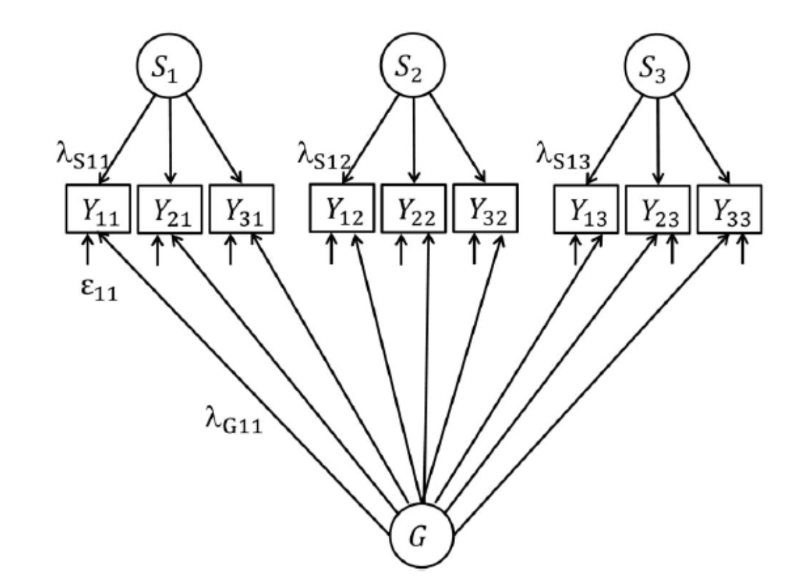
But haven’t we seen this all before?
There is much overlap between the considerations many psychologists (particularly psyshometricians) already make
The SEM framework can be interpreted in a similar way, but the arrows imply linear functions (and an arrow into an arrow implies moderation i.e. A*B)
See for instance, the well-known bifactor model of intelligence
- But… Many/most of the core concepts have not be generalised or used in general modelling practice in psychology

Slide 62
DAGs - Quick Caveat
A lot of the example graphs we will be using will be unrealistically simple!
Let us not end up on the wrong side of ‘parsimony’ when we use these techniques in practice!
Looks like this
If your model
It’s probably wrong
[Credit: Someone on twitter]

Slide 63
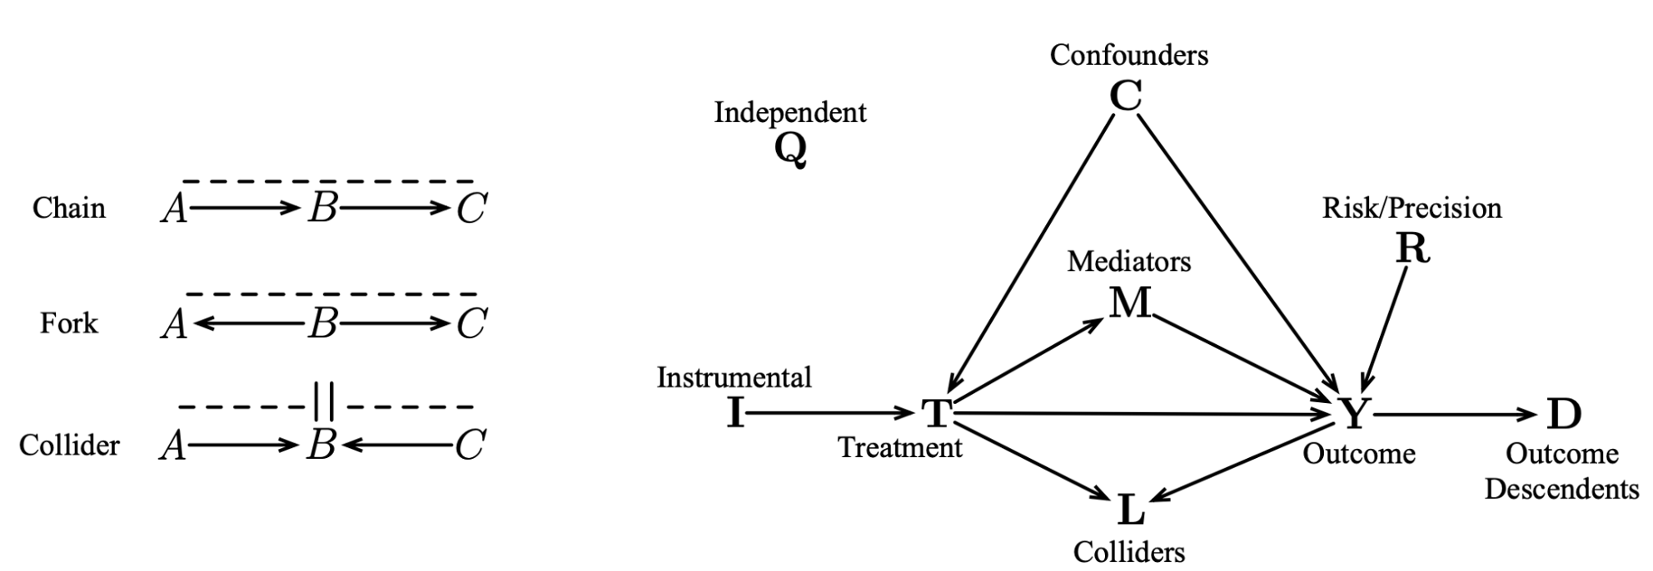
DAGs - Intro, structural primatives
Can construct all graphs from the following ‘sub-structures’:
The arrows indicate <causal dependencies> (although we should be clear that this is a causal DAG)

Slide 66
DAGs - Intro, structural primatives
Can construct all graphs from the following ‘sub-structures’:
The arrows indicate <causal dependencies> (although we should be clear that this is a causal DAG)

Slide 67
DAGs - Intro, functional form
Very similar to the graphical representation of Structural Equation Models (SEMs) which assume LINEARITY
No assumptions about the functional form
$$M:=f_{M}(X,U_{M})$$
M
X
Y
$$Y:=β_{0}+β_{X}X+β_{M}M+U_{Y}$$
$$X:=f_{X}(U_{X})$$
$$Y:=f_{Y}(M,X,U_{Y})$$

Slide 68
DAGs - Intro, what the DAG implies
Expanding the DAG to show the computational ordering…
Now we really are beginning to specify the Data Generating Process - note that time is implicit!
If we make assumptions about the functions f we can simulate data
Um
These are not correlated / dependent on each other - we call them exogenous
X is also exogenous (no parents)
$$f_{M}$$
M
Uy
Ux
$$f_{X}$$
X
$$f_{Y}$$
Y
We usually leave the U variables out unless they are correlated -> this means there is an unobserved variable!

Slide 69
DAGs - Intro, unobserved variables
Unobserved variables can be included like this:
U
M
X
Y
We can consider them in a similar way to how we treat observed variables
except we don’t have data for them, so can’t condition on them!

Slide 70
DAGs - Intro, some terminology
A -> B -> C
A is a parent of B
B is a child of A
C is a child of B
C is a descendent of A
A is an ancestor of C

Slide 71
Exercise
What would the DAG of your phenomenon look like?
We can try to refine this throughout the course.

Slide 72
DAGs - Intro, Challenges
Is anyone studying real-time processes?
What challenges did you encounter?
Did the process highlight any challenges
How you’d collect the data
Whether certain variables can be collected?

Slide 73
DAGs - Intro, Challenges
In dynamic, real-time scenarios, ‘causality’ can quickly becomes intractable
T0
T1
T2
B
B
B
U
T…
A
A
A
M
How often do we sample the data?
Have we missed links/variables?
If causality is bidirectional, what does it mean to estimate a causal effect?
Nonetheless, drawing the graph can be a very helpful exercise!
If we are interested in real-time processes but our data/models don’t reflect the necessary dynamics of the phenomenon, we are doomed…
Time helps with causality, but often not enough!

Slide 74

DAGs - Rules!
Then let’s start learning how to use them.

Slide 75
DAGs - Rules - From Causality to Statistics
Outside of experiments, we only have access to statistical dependencies - these may or may not be causal!
Need to understand independence and conditional independence
If things are linear, we can use correlation to measure statistics dependence between variables
But other measures of dependence exist (such as mutual information). In practice, these alternatives are difficult to use accurately/reliable.
This is why conditional expectations are more general than describing things in terms of correlation coefficients
X
Alcohol Consumption
T
Y
Sleep with
shoes on
Morning Headache
0
$$E[Y|T=1]-E[Y|T=0]≠0$$
$$E[Y|T=1,X]-E[Y|T=0,X]=0$$
$$Y=β_{0}+β_{T}T+β_{X}X+ϵ$$
and
$$Y=β_{0}+β_{T}T+ϵ$$
$$β_{T}T≠0$$
$$β_{T}T=0$$

Slide 76
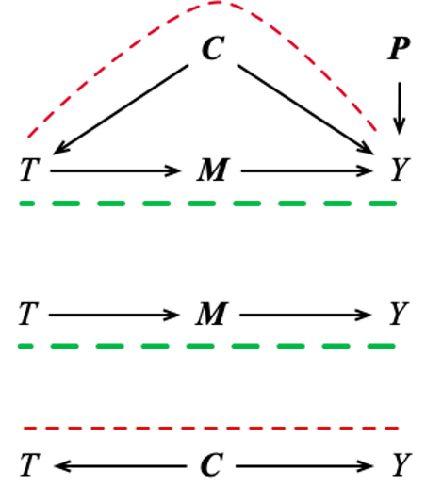
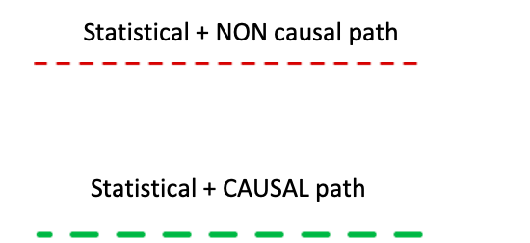
DAGs - Rules - From Causality to Statistics
As before… we only have access to statistical dependencies - these may or may not be causal
We need to extract/separate the statistical dependencies which are causal from the dependencies which are non-causal

Slide 77
DAGs - Rules - From Causality to Statistics
This is known as a backdoor path
We have to therefore know what to condition on (also known as adjustment or controlling)
We can clearly state what we are adjusting for with our conditional expectation…
e.g.
$$E[Y|T]$$
Our job will be to block them!

Slide 78
For continuous variables + the link with regression
Tells us we are regressing Y on X

Slide 79

DAGs - Rules - From Causality to Statistics
To know which variables we need to condition/control/adjust for we need to learn some rules…

Slide 80
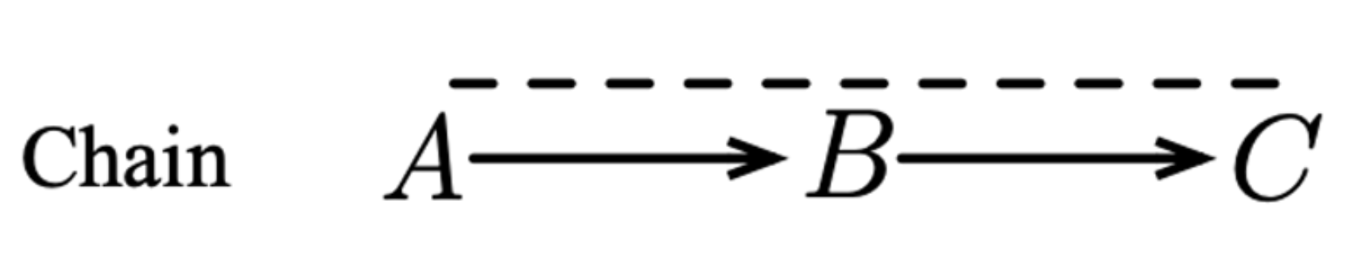
DAGs - Rules - From Causality to Statistics
Statistical information ‘flows’ from A to C through B indicated by - - - - - -
Thus, if we collect data for A and C they will be correlated / statistically dependent
This dependence arises as a result of the causal dependency chain
$$E[C|A=1]-E[C|A=0]≠0$$
$$C=β_{0}+β_{A}A+ϵ$$
$$β_{A}≠0$$

Slide 81
DAGs - Rules - From Causality to Statistics
But what if we condition on B?
$$C=β_{0}+β_{B}B+β_{C}A+ϵ$$
$$β_{A}=0$$
$$β_{B}≠0$$
This is because: if we know B, knowing A tells us nothing more on top.
This is the same as controlling for a mediator

Slide 82
DAGs - Rules - From Causality to Statistics
Remember we said we need consistency between these three?
Real-world causal process
Our Model/Theory
Our analysis
+ research question/estimand
This is why our analysis HAS to correspond with our model, and why our model needs to correspond as closely as possible with the Data Generating Process

Slide 83
DAGs - Rules - From Causality to Statistics
Otherwise, even if our theory is correct, our analysis can’t be used to answer the intended research question
If the analysis is not consistent with the theory (and the real-world).

Slide 84
DAGs - Rules - From Causality to Statistics
Let’s do some simulation to prove the point!
We will learn how to make this flawless ; )
Real-world causal process
Our Model/Theory
Our research question / estimand:
‘What is the causal effect of A on C?’
Or
$$τ=E[C|do(A=1)]-E[C|do(A=0)]$$
Be careful about whether you need another expectation…
ASSUME WE HAVE CONTROL OF THIS AND THIS

Slide 85


DAGs - Rules - From Causality to Statistics
Research Question:
A -> C
0.5
0.3
Some Simulation in R…
Ua = rnorm(60000)
Ub = rnorm(60000)
Uc = rnorm(60000)
A = Ua
B = 0.5 * A + Ub
C = 0.3 * B + Uc
mod = lm(C ~ A + B)
summary(mod)
mod = lm(C ~ A)
summary(mod)
Coefficients:
Estimate Std. Error t value Pr(>|t|)
(Intercept) -0.0077233 0.0040705 -1.897 0.0578 .
A 0.0006863 0.0045454 0.151 0.8800
B 0.3085893 0.0040461 76.268 <2e-16 ***
Generate exogenous noise/variation
Generate data (linear) according to graph
Coefficients:
Estimate Std. Error t value Pr(>|t|)
(Intercept) -0.006338 0.004263 -1.487 0.137
A 0.155984 0.004256 36.649 <2e-16 ***
Run linear model with all three variables
Run linear model without the mediator
1A

Slide 86
DAGs - Rules - From Causality to Statistics
Research Question:
A -> C
mod = lm(C ~ A, data=data)
A1 = data.frame(cbind(C, rep(1, length(A))))
A0 = data.frame(cbind(C, rep(0, length(A))))
colnames(A1) <- c('C', 'A')
colnames(A0) <- c('C', 'A')
Cdo1 = predict(mod, newdata = A1)
Cdo0 = predict(mod, newdata = A0)
Cdiff = Cdo1 - Cdo0
mean(Cdiff)
We can also treat our LR as a black box…
Create some new data with A = 1 and A = 0
Generate predictions for C in each case
Compare the different predictions and average them
This gives us the same result as the coefficient in the model summary!
1A

Slide 87
DAGs - Rules - From Causality to Statistics
So… Our theory was correct (we guaranteed this when we created the data ourselves).
We knew that the effect of A on C was non-zero
(actually, it was 0.3*0.5 = 0.15)
But whether we included B (i.e., whether we conditioned on B) in the regression completely changed the results.

Slide 88
DAGs - Rules - From Causality to Statistics
The rules we will cover will help us understand whether certain variables should be included or excluded from the analysis/conditioning statement.
Without the graph / formal theory, we have no idea what we are doing when we specify a regression / conditioning statement!
Furthermore, in practice we probably don’t have the correct theory either! Thus the chances of our results being meaningless is…. Kinda high…

Slide 89
import statsmodels.api as sm
import numpy as np
import pandas as pd
Ua = np.random.randn(60000)
Ub = np.random.randn(60000)
Uc = np.random.randn(60000)
A = Ua
B = 0.5 * A + Ub
C = 0.3 * B + Uc
df = pd.DataFrame([A,B,C]).T
df.columns = ['A','B','C']
preds = sm.add_constant(df[['A','B']], prepend=False)
outcome = df['C']
mod = sm.OLS(outcome, preds)
print(mod.fit().summary())
Ua = rnorm(60000)
Ub = rnorm(60000)
Uc = rnorm(60000)
A = Ua
B = 0.5 * A + Ub
C = 0.3 * B + Uc
mod = lm(C ~ A + B)
summary(mod)

Slide 90
Reflection
Thus: if either our model disagrees with the world, and/or our analysis is not consistent with the model….
Then our results are meaningless = arbitrarily biased
How many times do you think they correspond in general practice?

Slide 91
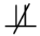
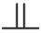
DAGs - RULE 1 (chain)
In the world, statistical dependence exists between A, B, and C
C
A
These are known as independency statements, or conditional independency statements
Statements:
C
B
A
B
Conditioning on B makes A statistically independent of C
C
A | B
We already simulated this!
Statements:
C
B
A
B

Slide 92
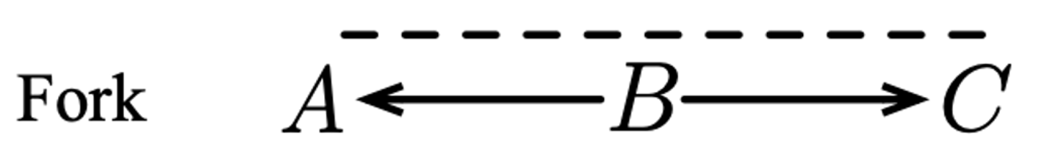
DAGs - RULE 2 (fork)
In the world, statistical dependence exists between A, B, and C
C
A
Statements:
C
B
A
B
Conditioning on B makes A statistically independent of C
C
A | B
Statements:
C
B
A
B

Slide 93
DAGs - RULE 2 (fork)
Research Question:
BS -> MH
Alcohol Consumption (AC)
Some Simulation in R…
Coefficients:
Estimate Std. Error t value Pr(>|t|)
(Intercept) 0.004849 0.004141 1.171 0.242
BS 0.062347 0.003826 16.296 <2e-16 ***
Uac = rnorm(60000)
Ubs = rnorm(60000)
Umh = rnorm(60000)
AC = Uac
BS = 0.4 * AC + Ubs
MH = 0.2 * AC + Umh
mod = lm(MH ~ BS)
summary(mod)
mod = lm(MH ~ BS + AC)
summary(mod)
Generate exogenous noise/variation
0.4
0.2
Generate data (linear) according to graph
Coefficients:
Estimate Std. Error t value Pr(>|t|)
(Intercept) 0.003984 0.004071 0.979 0.328
BS -0.005451 0.004044 -1.348 0.178
AC 0.200390 0.004391 45.636 <2e-16 ***
Bed with Shoes
(BS)
Morning Headache (MH)
Run linear model with only BS and MH variables
0
Run linear model with AC as well
1B

Slide 94
DAGs - RULE 2 (fork)
Research Question:
BS -> MH
Alcohol Consumption (AC)
Some Simulation in R…
0.4
0.2
Once again, we can create new data, setting BS to 1 and to 0, and using the predict(mod, newdata=..) function, we can generate predictions and come to the same result
Bed with Shoes
(BS)
Morning Headache (MH)
0
1B

Slide 95
DAGs - RULE 2 (fork)
In the world, statistical dependence exists between A, B, and C
C
A
Statements:
C
B
A
B
Conditioning on B makes A statistically independent of C
C
A | B
Statements:
C
B
A
B

Slide 96
Reflection
Notice that the rules for fork and chain were essentially the same, even though they have very different causal implications
Chain: A -> B -> C
Fork: A <- B -> C
Playing with the directions of arrows in mediation models is likely to not have an effect -> if you don’t know which way the arrows go… your theory probably isn’t very convincing anyway!

Slide 97
Reflection
Notice also that the control variables are there to get us unbiased estimation of the thing we care about…
We should not be interpreting the coefficients on the control variables themselves!

Slide 98
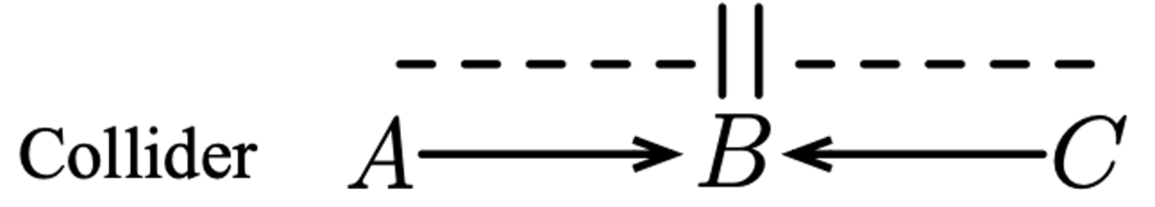
DAGs - RULE 3 (collider + descendants)
In the world, statistical dependence does not exist between A and C
C
A
Statements:
C
B
A
B
Conditioning on B makes A statistically dependent on C
-
C
A | B
Statements:
C
B
A
B

Slide 99
DAGs - RULE 3 (collider)
Research Question:
GL -> AS
Success in Hollywood (SH)
Some Simulation in R…
Coefficients:
Estimate Std. Error t value Pr(>|t|)
(Intercept) 0.002535 0.004103 0.618 0.537
GL 0.006287 0.004084 1.539 0.124
Ugl = rnorm(60000)
Ush = rnorm(60000)
Uas = rnorm(60000)
GL = Ugl
AS = Uas
SH = 0.4 * GL + 0.3 * AS
+ Ush
mod = lm(AS ~ GL)
summary(mod)
mod = lm(AS ~ GL + SH)
summary(mod)
Generate exogenous noise/variation
0.4
0.3
Generate data (linear) according to graph
Coefficients:
Estimate Std. Error t value Pr(>|t|)
(Intercept) 0.002608 0.003934 0.663 0.507
GL -0.104297 0.004204 -24.811 <2e-16 ***
SH 0.273234 0.003773 72.423 <2e-16 ***
Good Looks
(GL)
Run linear model with only GL and AS variables
0
Acting Talent (AS)
Run linear model with SH as well
1C

Slide 100
Reflection
In combination with Rules 1 (chain) and 2 (fork) it should be clear that we need to be careful about which variables we control for! We will speak more about this in the next lecture!

Slide 101
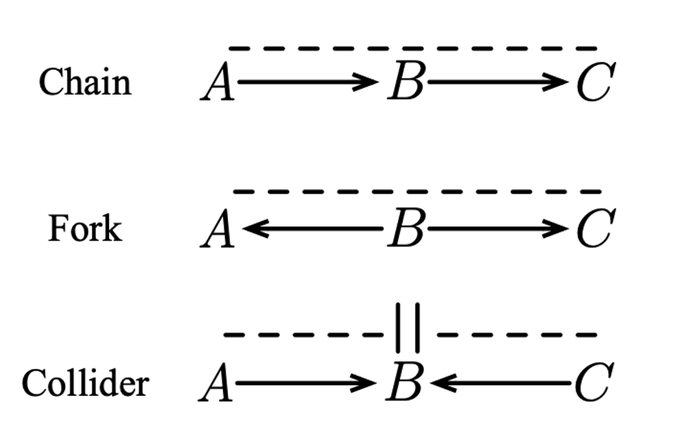
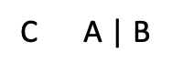
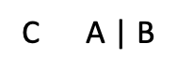
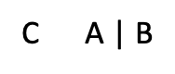
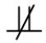
DAGs - RULE SUMMARY
(Plus descendants of B)

Slide 102
DAGs - Bonus
In linear models (e.g. path diagrams and SEMs) we can multiply and sum causal coefficients to get total effects
B
e.g.
0.5
0.2
A
C
D
0.3
0.5
The effect of A on D is (0.5 * 0.2) + (0.3 * 0.5) = 0.25
i.e. each causal path’s contributions are multiplied, and then the different paths are summed
But… maybe we won’t spend forever in linear-land

Slide 103

DAGs - Bonus
But… maybe we won’t spend forever in linear-land

Slide 104
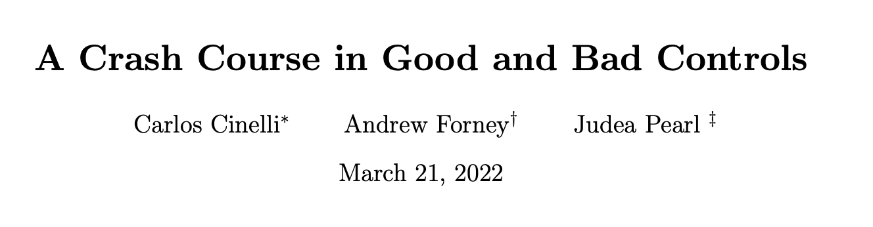
DAGs - SUMMARY
We need a graph to know which variables to control for and which to not control for
‘Good and bad controls’ We need a research question relating to something in that graph
If we don’t get this right, the coefficient estimates will be arbitrarily wrong !
We should not be interpreting control variable coefficients
Sometimes identifying the right controls is tricky!

Slide 105
03 Causal Identification and Backdoor Criterion

Slide 106
Recap
Last time we were already doing what we need to cover today
Specifying the graph
Observing that controlling for certain variables can have a big effect on our estimates
We know three rules
A -> B -> C (chain), controlling for B blocks statistical dependence between A and C [think about the bone length and height example]
A <- B -> C (fork), controlling for B also blocks statistical dependence between A and C
A -> B <- C (collider), there is no statistical dependence between A and C, but controlling for B induces dependence
We went through some examples showing the impact of controlling/not controlling
Today, we will cover this a little bit more formally

Slide 107
Questions?

Slide 108
Reflection
How many times do you think our effect sizes are meaningful in general practice?
Why?

Slide 109
DAGs - Backdoor Paths
Think about the real-world phenomenon
Specify a graph
Identify a research question / hypothesis / estimand
Specify your analysis according to this estimand (and block backdoor paths!)
Interpret your estimate

Slide 110
DAGs - Backdoor Paths
Backdoor paths are non-causal paths that link two variables of interest
A non-causal path is a path which results in statistical dependence, but which cannot be followed according to the direction of the arrows.
The backdoor criterion allows us to identify the estimand from observational data, under the assumption that the graph is correctly specified

Slide 111
DAGs - Backdoor Paths
Said in a different way…
If our graph is correct and we can block the backdoor paths between variables, then we can estimate causal effects from observational data.
i.e. Correlation can be causation

Slide 112
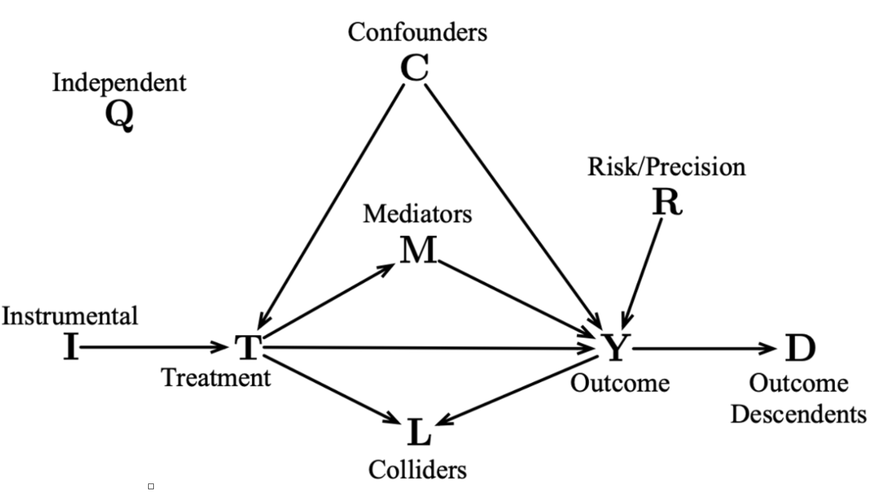
DAGs - Other Variables
These we want to adjust for (to block the backdoor path)
These are unrelated
DON’T control
DO control
These can help us tighten our estimates
Optional control
These ‘steal’ variance
These ‘steal’ variance
These we <shouldn’t> adjust for (if we do, we open a backdoor path)

Slide 113
Exercises…
Think about the real-world phenomenon
Specify a graph
Identify a research question / hypothesis / estimand
Specify your analysis according to this estimand
Interpret your estimate

Slide 114
Exercises continued…
Real-world Phenomenon:
French Lit. Score (FS)
IQ
Class Size
(CS)
Math Score (MS)

Slide 115
Exercises continued…
Specify the graph:
French Lit. Score (FS)
IQ
Class Size
(CS)
Math Score (MS)

Slide 116

Exercises continued…
Specify the Research Question / Estimand
French Lit. Score (FS)
IQ
Class Size
(CS)
Math Score (MS)
$$τ=E[MS|do(CS=1)]-E[MS|do(CS=0)]$$

Slide 117
Exercises continued…
Answer:
Think about the expectation first…
$$E[MS|CS]$$
Corresponding regression (in R):
MS ~ CS
French Lit. Score (FS)
Specify the Analysis
IQ
Class Size
(CS)
Math Score (MS)
1. Are there any non-causal statistical paths?
2. Specify the regression equation
Answer = Nope!

Slide 118
Exercises continued…
CODE THIS YOURSELF IN R OR PYTHON:
French Lit. Score (FS)
0.5
IQ
-0.4
0.5
Class Size
(CS)
Math Score (MS)
-0.3
Assume all exogenous noise is Normally distributed with mean = 0 and var = 1

Slide 119
DAGs - Collider Exercise
Research Question:
CS -> MS
Some Simulation in R…
Ucs = rnorm(60000)
Ufs = rnorm(60000)
Uiq = rnorm(60000)
Ums = rnorm(60000)
CS = Ucs
IQ = Uiq
MS = 0.5 * IQ -0.3 * CS + Ums
FS = 0.5 * IQ - 0.4 * CS + Ufs
mod = lm(MS ~ CS)
summary(mod)
mod = lm(MS ~ CS + FS)
summary(mod)
French Lit. Score (FS)
Generate exogenous noise/variation
Estimate Std. Error t value Pr(>|t|)
(Intercept) 0.004889 0.004569 1.07 0.285
CS -0.301312 0.004571 -65.92 <2e-16 ***
0.5
-0.4
IQ
0.5
Generate data (linear) according to graph
Class Size
(CS)
-0.3
Math Score (MS)
(Intercept) 0.006214 0.004475 1.389 0.165
CS -0.221945 0.004744 -46.781 <2e-16 ***
FS 0.201602 0.003991 50.518 <2e-16 ***
Run linear model with only CS and MS variables
1D
Run linear model with FS as well

Slide 120
Exercises continued…
French Lit. Score (FS)
Interpret Estimate
IQ
Class Size
(CS)
Math Score (MS)
Estimate Std. Error t value Pr(>|t|)
(Intercept) 0.003765 0.004577 0.823 0.411
CS -0.297325 0.004580 -64.917 <2e-16 ***
“Every one unit that we increase in class size causes math score to decrease by 0.3 points"

Slide 121
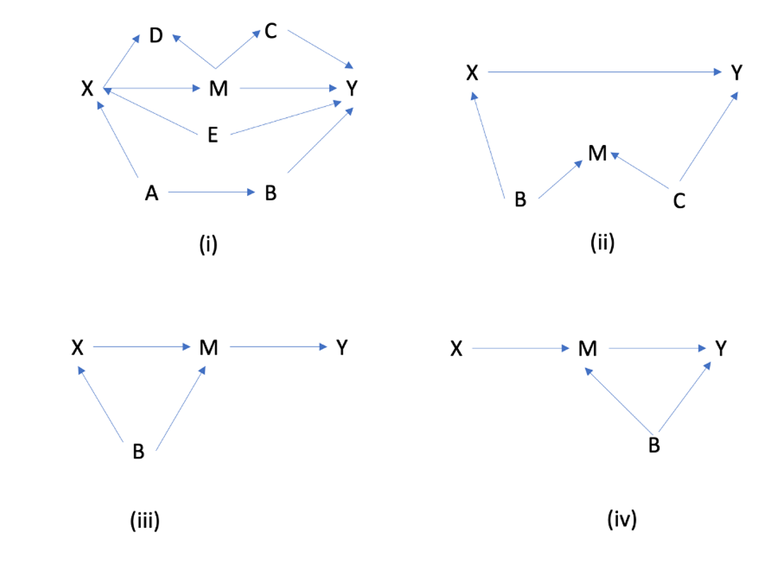
Exercises
1. Research Question / Estimand
What is the causal effect of X on Y?
$$τ=E[Y|do(X=1)]-E[Y|do(X=0)]$$
2. (For us!) Specify the adjustment/identification formula and regression equation for each graph which facilitates unbiased estimation of the estimand by blocking backdoor paths
Let’s work through the first one together.

Slide 122
Exercises
Estimand:
$$τ=E[Y|do(X=1)]-E[Y|do(X=0)]$$
Applying the backdoor criterion:
$$τ=E_{E,A}[E[Y|E,A,X=1]-E[Y|E,A,X=0]]$$
The outer expectations are there because otherwise we end up with a value for every combination of values in E and A (i.e. we average over these extra conditions).
Our linear regression takes care of this for us…
Y ~ X + A + E
Note that instead of including A, we could have used B, or {A, B} both!
<——- This is the identification formula. It is estimable from the observed data

Slide 123
Exercises
1. Research Question / Estimand
What is the causal effect of X on Y?
$$τ=E[Y|do(X=1)]-E[Y|do(X=0)]$$
2. (For us!) Specify the adjustment/identification formula and regression equation for each graph which facilitates unbiased estimation of the estimand by blocking backdoor paths

Slide 124
DAGs - Other Variables
These we want to adjust for (to block the backdoor path)
These are unrelated
DON’T control
DO control
These can help us tighten our estimates
Optional control
These ‘steal’ variance
These ‘steal’ variance
These we <shouldn’t> adjust for (if we do, we open a backdoor path)

Slide 125
Assumptions
Be clear about them!

Slide 126
DAGs - Mediation
Now we really have 3 estimands! And we could just use SEM, but remember that SEM is linear, so the techniques we apply here can be generalised beyond linear models!
Research Question:
T -> Y and T -> BP -> Y
Note: Total effect (0.2*0.4) + (-0.3) = -0.22
Ut = rnorm(60000)
Uy = rnorm(60000)
Ubp = rnorm(60000)
T = Ut
BP = 0.2 * T + Ubp
Y = -0.3*T + 0.4*BP
data = data.frame(cbind(T, BP, Y))
mod = lm(Y ~ T, data=data)
summary(mod)
mod = lm(Y ~ T + BP, data=data)
summary(mod)
mod = lm(BP ~ T , data=data) summary(mod)
Generate exogenous noise/variation
BP
0.2
0.4
Generate data (linear) according to graph
-0.3
T
Y
Run linear model with only CS and MS variables
1E

Slide 127
Assumptions
It is incredibly important to specify the assumptions which are assumed to hold for the statistical quantities (i.e. correlations) to be causal!
That our graph/theory is ‘correct’
‘Correct’ in terms of observed variables
‘Correct’ in terms of unobserved variables (ignorability / exchangeability) i.e. $T(Y(1),Y(0))|C$
‘Positivity’ - do we actually have data for people under all treatment scenarios of interest with all subgroups of interest? i.e. $p(t|c=c_{i})>0∀i,t$
3. SUTVA - Stable Unit Treatment Value Assignment
i.e. the potential outcomes for each individual or data unit are independent of the treatments assigned to all other individuals.

Slide 128
Popular Estimands
$$APO=E[Y|do(T=1)]$$
$$ATE=E[Y|do(T=1)]-E[Y|do(T=0)]$$
$$CATE_{i}=E[Y|do(T=1),X=x_{i}]-E[Y|do(T=0),X=x_{i}]$$
Note that this is not really an individual treatment effect!

Slide 129
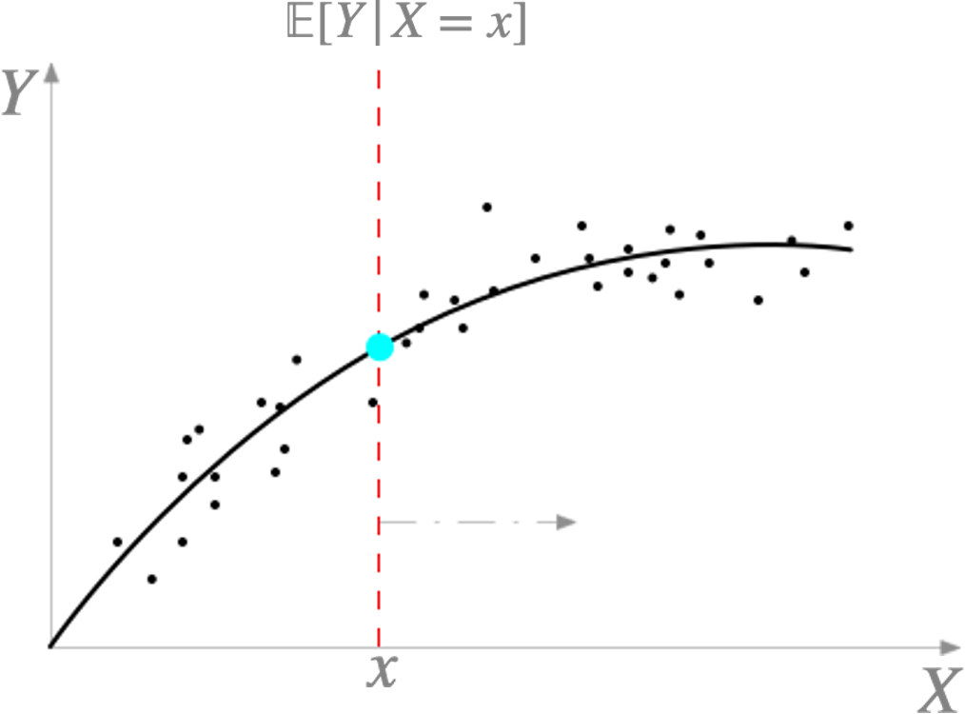
Popular Estimands
$$CATE_{i}=E[Y|do(T=1),X=x_{i}]-E[Y|do(T=0),X=x_{i}]$$

Slide 130
Questions?

Slide 131
A Little Causal Discovery…
We have seen the following structures and the conditional independencies which are implied
(Plus descendants of B)
These conditional independencies helped us understand which variables should be controlled for to make our estimates causal.

Slide 132
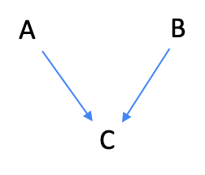
Some Causal Discovery…
These conditional independencies can also help us discover the structure from the data.
Implied CIs?
-
-
-
-
Example ‘True’ Graph:

Slide 133
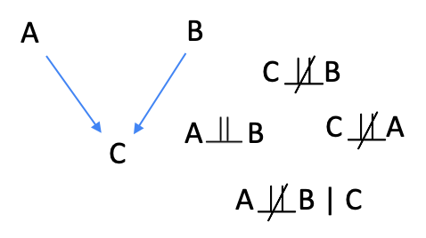
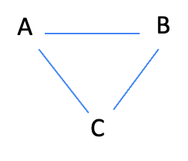
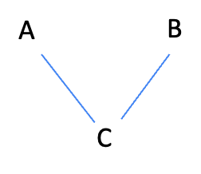
Some Causal Discovery…
Example ‘True’ Graph:
Step 4 - Test Pairwise Conditional Correlations
Corr(A, B | C) != 0
The only structure consistent with this is:
Putative Graph
Step 1 - Assume all (undirected) links
Step 2 - Test Pairwise Correlations e.g. (A, B| {})
Corr(A,B) = 0
Corr(A,C) != 0
Corr(C,B) != 0
Step 3 - Update Graph
This is the ‘skeleton’

Slide 134
Some Causal Discovery…
Example ‘True’ Graph:
Neal, 2020 (online course)

Slide 135
04 Machine Learning and Estimation

Slide 136
Machine Learning Basics

Slide 137
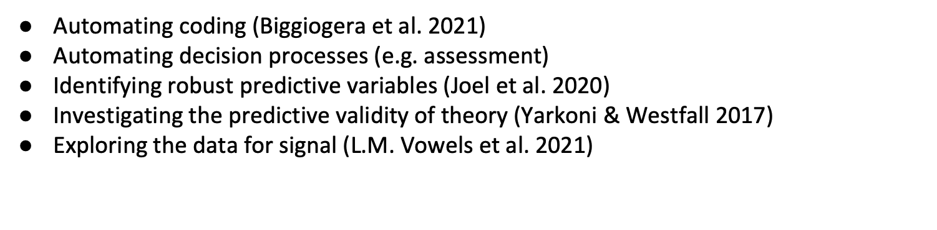
Machine Learning for Prediction
For the most part, these are tasks with some utility but only indirect links to theory building

Slide 138
Machine Learning for Causal Inference
We want to avoid making unrealistic assumptions about the functions relating variables
Then we can get better estimation of the causal quantities we actually care about
We need to think a little bit carefully about how to do statistical inference with the results (C.I.s and p-values)

Slide 139
Machine Learning - Prediction vs Estimation
It is worth have a little separation between the two tasks in your mind…
Prediction is (usually) concerned with leveraging any and all correlations to predict something with high accuracy (When? Which? How much?)
Parameter estimation is concerned with estimating a particular quantity like a causal effect
But there is much overlap… one could define the quantity of interest to be a person’s symptoms following treatment, this is both a predictive task as well as one of parameter estimation.

Slide 140
Machine Learning - Prediction vs Estimation
Linear Regression
Fancy ML Algorithm
This choice <should> be primarily determined by your knowledge about the function being modelled.
Note, however, that with linear regression you also get parameters ‘for free’ (the coefficients).
When we use LR with OLS for parameter estimation, we use a ‘predictive goal’ to derive a set of parameters.
We have the same goal with the ML algorithm, but we have to undertake a second step to get the parameter (e.g. intervening on the data and generating predictions under contrast - set T=1 and T=0).

Slide 141
Machine Learning Basics
$$E[Y|X=x]=∫yf(y|x)dy$$

Slide 142
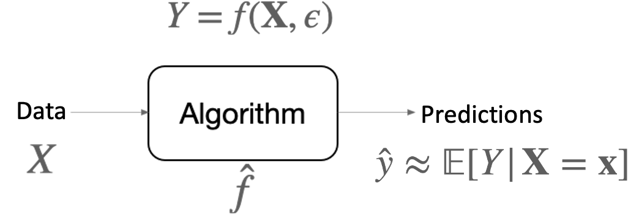
Machine Learning Basics
Example Algorithms:
Example Tasks:
Linear Regression
Support Vector Machines
Random Forests
Nearest-Neighbour variants
MultiLayer Perceptrons
Deep Neural Networks
….
Classification
Regression
Clustering
Representation Learning
…
Causal inference!

Slide 143

Machine Learning Basics
As an example, the decision tree carves up the input space.
A random forest does the same thing, but with a ‘forest’ of decision trees. Each tree is trained on a different random subset of the dataset’s rows and variables (bagging).

Slide 144
Machine Learning Basics
Implementation of these algorithms can be quite easy!
Linear Model
Random Forest
mod = lm(outcome ~ predictors)
forest<- cforest(outcome ~ predictors, data = train_data)
mod = sm.OLS(outcome, predictors)
res = mod.fit()
mod = RandomForestRegressor()
res = mod.fit(outcome, predictors)
But there are some additional considerations…

Slide 145
Machine Learning Basics
Doing train/test splitting in code…
Split into train + val combined and test separately:
X_train_val, X_test, y_train_val, y_test = train_test_split(X, y, test_size=0.2, random_state=42)
X_train, X_val, y_train, y_val = train_test_split(X_train_val, y_train_val, test_size=0.25, random_state=42)
rf = RandomForestRegressor()
dt = DecisionTreeRegressor()
lr = LinearRegression()
rf.fit(X_train, y_train)
dt.fit(X_train, y_train)
lr.fit(X_train, y_train)
rf_preds_train = rf.predict(X_train)
dt_preds_train = dt.predict(X_train)
lr_preds_train = lr.predict(X_train)
rf_preds_val = rf.predict(X_val)
dt_preds_val = dt.predict(X_val)
lr_preds_val = lr.predict(X_val)
Repeat to split combined train+val into separate splits
Define and fit algorithms
Generate train and validation predictions

Slide 146
Machine Learning Basics
Doing train/test splitting in code…
rf_mse_train = ((rf_preds_train - y_train)**2).mean()
dt_mse_train = ((dt_preds_train - y_train)**2).mean()
lr_mse_train = ((lr_preds_train - y_train)**2).mean()
rf_mse_val = ((rf_preds_val - y_val)**2).mean()
dt_mse_val = ((dt_preds_val - y_val)**2).mean()
lr_mse_val = ((lr_preds_val - y_val)**2).mean()
Evaluate train and validation performance
Algo. | Train MSE | Validation MSE
LR | 0.902 | 0.995
RF | 0.143 | 1.162
DT | 0.0 | 2.052
Test MSE
lr_preds_test = lr.predict(X_test)
lr_mse_test = ((lr_preds_test - y_test)**2).mean()
0.987

Slide 147
Machine Learning Basics
So far… A few things to notice
There are differences in the results from R and Python
This can be due to random seed (we are randomly generating new data each time)
Differences in hyperparameters
Differences in implementation
We don’t only have to have multiple different algorithms - we can also have multiple copies of the same algorithm with different hyperparameters
When we split the data, we lose power (less training data, and noisy estimates for performance)
Doing the test/validation step is a bit like running a confirmatory study / replication - we should be doing it more often! But note that it doesn’t quite carry over as simply as this for causal effect estimation (more on this later)
In the meantime… how can we make better use of the data?

Slide 148
Machine Learning Basics
K-fold Cross-Validation
e.g. k = 5
Fold_1 = 20%
Fold_2 = 20%
Fold_3 = 20%
Fold_4 = 20%
Fold_5 = 20%
Select 4/5 folds (e.g. folds 1-4) -> Train Algorithm
Select remaining gold (fold 5) Store Test predictions
3. Repeat process until all folds used as test folds

Slide 149

Machine Learning Basics
(Red/Orange)

Slide 150

Machine Learning Basics

Slide 151
Machine Learning Basics
To detect these problems we can use various data splitting techniques
Train / Test (e.g. 60 / 40 %)
Train / Validation / Test (e.g. 60 / 20 / 20 %)
K-fold Cross-Validation
Leave One Out Cross-Validation (LOO-CV)
Nested Cross-Validation
Let’s see how this helps with the simple train / test split

Slide 152
Machine Learning Basics
Train / Test Splitting
Training Data (60%)
Test Data (40%)
Use this for fitting the algorithm
Use this for checking the performance
The test data should not be used for <ANY> decision which concerns the choice for settings of the algorithm!

Slide 153
Machine Learning Basics
Train / Test Splitting - Why does this help?
When we overfit: good training performance, bad test performance
True function
ML function
Training Data (60%)
Test Data (40%)

Slide 154
Machine Learning Basics
Train / Test Splitting - Why does this help?
When we underfit: OK/poor training performance, OK/poor test performance
True function
ML function
Training Data (60%)
Test Data (40%)
So the train and test performance can give us clues as to whether or not our ML algorithm is too flexible, or not flexible enough.

Slide 155
Machine Learning Basics
Doing train/test splitting in code…
library(party)
library(caret)
library(tidyverse)

Slide 156
Machine Learning Basics
Doing train/test splitting in code…
Generate data and store in data frame
Get indices for 60% train split, and get those rows from the dataset
Ucs = rnorm(60000)
Ufs = rnorm(60000)
Uiq = rnorm(60000)
Ums = rnorm(60000)
CS = Ucs
IQ = Uiq
FS = 0.5 * IQ - 0.4 * CS + Ufs
outcome = 0.5 * IQ - 0.3 * CS + Ums
data = data.frame(CS, IQ, FS, outcome)
intrain <- createDataPartition(y = data$outcome, p= 0.6, list = FALSE)
all_train_split <- data[intrain,]
all_test_split <- data[-intrain,]
forest<- cforest(outcome ~ ., data = all_train_split)
preds_train <- predict(forest, newdata = all_train_split)
preds_test <- predict(forest, newdata = all_test_split)
mse_train <- mean((all_train_split$outcome - preds_train)^2)
mse_test <- mean((all_test_split$outcome - preds_test)^2)
mae_train <- mean(abs(all_train_split$outcome - preds_train))
mae_test <- mean(abs(all_test_split$outcome - preds_test))
Train RF
Generate predictions
Evaluate train and test performance
$$MSE=\frac{1}{N_{tr}}\overset{N_{tr}}{\underset{i}{∑}}({\overset{̂}{y}}_{i}-y_{i})^{2}$$
$$MAE=\frac{1}{N_{tr}}\overset{N_{tr}}{\underset{i}{∑}}|{\overset{̂}{y}}_{i}-y_{i}|$$
This gives mse_train = 0.776 and mse_test = 1.084

Slide 157
Machine Learning Basics
import numpy as np
import pandas as pd
from sklearn.model_selection import train_test_split
from sklearn.ensemble import RandomForestRegressor

Slide 158
Machine Learning Basics
Doing train/test splitting in code…
Get train and test rows from data
Generate data and store in data frame
X_train, X_test, y_train, y_test = train_test_split(X, y, test_size=0.4, random_state=42)
rf = RandomForestRegressor()
rf.fit(X_train, y_train)
preds_train = rf.predict(X_train)
preds_test = rf.predict(X_test)
mse_train = ((preds_train - y_train)**2).mean()
mse_test = ((preds_test - y_test)**2).mean()
mae_train = (np.abs(preds_train - y_train)).mean()
mae_test = (np.abs(preds_test - y_test)).mean()
Ucs = np.random.randn(1000)
Ufs = np.random.randn(1000)
Uiq = np.random.randn(1000)
Ums = np.random.randn(1000)
CS = Ucs
IQ = Uiq
FS = 0.5 * IQ - 0.4 * CS + Ufs
outcome = 0.5 * IQ - 0.3 * CS + Ums
data = pd.DataFrame([CS, IQ, FS, outcome]).T
data.columns = [‘CS','IQ','FS','outcome']
X = data[['CS','IQ','FS']]
y = data['outcome']
Train RF
Generate predictions
Evaluate train and test performance
This gives mse_train = 0.165 and mse_test = 1.01

Slide 159
Machine Learning Basics
mse_train = 0.776 (R example)
mse_test = 1.084
What do we do with these results?
Not a lot…
Remember that <we shouldn’t use the test data to make decisions about the model!
- But it nonetheless provides an estimate of the ‘risk’ / error of the model for unseen data.
Really what we need is to consider other data splitting strategies…

Slide 160
Machine Learning Basics
Train / Validation / Test Splitting
Training Data (60%)
Validation Data (20%)
Test Data (20%)
Use this for making algorithm/modeling decisions
Use this for fitting the algorithm
Use this for checking the performance
Again… the test data should not be used for <ANY> decision which concerns the choice for settings of the algorithm!

Slide 161
Machine Learning Basics
Train / Validation / Test Splitting - Why does this help?
When we overfit: good training performance, bad validation performance
When we underfit: OK/poor training performance, OK/poor validation performance
True function
ML function 1
ML function 2
ML function 3
Training Data (60%)
Validation Data (20%)
Test Data (20%)
We can now use the validation data to select between different models.

Slide 162
Machine Learning Basics
Train / Validation / Test Splitting - Why does this help?
But we can now have multiple models:
True function
ML function 1
ML function 2
ML function 3
Algo. | Train MSE | Validation MSE
ML 1 | 0.5 | 1.2
ML 2 | 0.6 | 0.65
ML 3 | 0.9 | 0.9
Test MSE
Select the best one based on validation performance and finally test it
0.6

Slide 163
Machine Learning Basics
Doing train/validation/test splitting in code…
Get indices for 80% of the data (train and validation combined)
intrainval <- createDataPartition(y = data$outcome, p= 0.8, list = FALSE)
all_trainval_split <- data[intrainval,]
all_test_split <- data[-intrainval,]
intrain <- createDataPartition(y = all_trainval_split$outcome, p= 0.75, list = FALSE)
all_train_split <- all_trainval_split[intrain,]
all_val_split <- all_trainval_split[-intrain,]
rf <- cforest(outcome ~ ., data = all_train_split)
lr <- lm(outcome ~ ., data = all_train_split)
dt <- ctree(outcome ~ ., data = all_train_split)
Get test split, as well as combined train and validation split
Repeat the splitting process to split the combined train + val into train / val
Train RF, LR, DT

Slide 164
Machine Learning Basics
Doing train/validation/test splitting in code…
rf_preds_train <- predict(rf, newdata = all_train_split)
lr_preds_train <- predict(lr, newdata = all_train_split)
dt_preds_train <- predict(dt, newdata = all_train_split)
rf_preds_val <- predict(rf, newdata = all_val_split)
lr_preds_val <- predict(lr, newdata = all_val_split)
dt_preds_val <- predict(dt, newdata = all_val_split)
Generate train and validation predictions
rf_mse_train <- mean((all_train_split$outcome - rf_preds_train)^2)
rf_mse_val <- mean((all_val_split$outcome - rf_preds_val)^2)
lr_mse_train <- mean((all_train_split$outcome - lr_preds_train)^2)
lr_mse_val <- mean((all_val_split$outcome - lr_preds_val)^2)
dt_mse_train <- mean((all_train_split$outcome - dt_preds_train)^2)
dt_mse_val <- mean((all_val_split$outcome - dt_preds_val)^2)
Evaluate RF, LR and DT
Algo. | Train MSE | Validation MSE
LR | 1.026 | 0.934
RF | 0.766 | 1.076
DT | 1.009 | 1.043
Test MSE
lr_preds_test <- predict(lr, newdata = all_test_split)
lr_mse_test <- mean((all_test_split$outcome - lr_preds_test)^2)
1.17

Slide 165
Machine Learning Basics
import numpy as np
import pandas as pd
from sklearn.model_selection import train_test_split
from sklearn.ensemble import RandomForestClassifier
from sklearn.linear_model import LinearRegression
from sklearn import tree

Slide 166
Machine Learning Basics
K-fold Cross-Validation
e.g. k = 5
Fold_1 = 20%
Fold_2 = 20%
Fold_3 = 20%
Fold_4 = 20%
Fold_5 = 20%
Select 4/5 folds (e.g. folds 2-5) -> Train Algorithm
Select remaining gold (fold 1) Store Test predictions

Slide 167
Machine Learning Basics
e.g. k = 5
2
3
4
5
Training Folds
1
3
4
5
1
2
4
5
1
2
3
5
1
2
3
4
Test Fold_1 = 20%
Test Fold_2 = 20%
Test Fold_3 = 20%
Test Fold_4 = 20%
Test Fold_5 = 20%
Full Sample’s Worth of Predictions

Slide 168
Machine Learning Basics
Leave-One-Out Cross-Validation (LOO-CV)
The same as k-fold CV, but k = N !
It can be quite time consuming (you end up training and testing N models!
But it makes the most of your data (your model is trained on all but one datapoint)

Slide 169
Machine Learning Basics
Nested k-fold Cross-Validation
The problem with k-fold CV is that it doesn’t help us with model selection!
So we have to nest another level of k-fold CV to select the best model

Slide 170
Machine Learning Basics
Nested k-fold Cross-Validation
e.g. k1 = 5, k2 = 5
OUTER LOOP
Fold_1 = 20%
Fold_2 = 20%
Fold_3 = 20%
Fold_4 = 20%
Fold_5 = 20%
INNER LOOP
N1 = 20%
N2 = 20%
N3 = 20%
N4 = 20%
N5 = 20%
Best inner loop
Model
Training Data
Validation Data
Test best model
(Different model for each iteration of the outer loop)
Train all models
Get validation results for each model
(Repeat and collect validation fold results, use these to select the best model)

Slide 171
Machine Learning Basics
Nested k-fold Cross-Validation
<Very> computationally expensive (k1 x k2 x M where M is the number of models). For k1 = 10, k2 = 4 and M = 10 this is 400 algorithms that must be trained
Can give you a different model for each of the outer-folds (based on the performance on the inner-loop), making it difficult to know which model to actually use in practice
- Allows for proper hyperparameter search, so gives you an idea of the upper bound on performance

Slide 172
Questions?

